Slide 1
ArcGIS Workforce integration with other mobile apps
April 7th, 2021
Software Engineering GIS, KCIT

Slide 2
ArcGIS Workforce
Mobile solution
Coordinate field workforce
Manage work assignments
Field data collection
Reduce use of paper forms
Location tracking (ArcGIS Tracker)

Slide 3
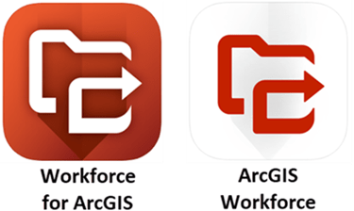
New Workforce
Migrate your old projects
Migrate your data in one go
Use a script or the link available in Workforce to migrate
Old Workforce app is not available to download
Old workforce projects referred as Classic projects

Slide 4
Workflow
Create & assign assignments
(Dispatcher)
Complete assignments
(Mobile Worker)
Dispatch
work

Slide 5
General functionality
Get assignments in real-time
Complete assignments as you go
Organize your list to do by due time
View your assignments in the map
Location tracking
Monitoring in dashboards

Slide 6
Exciting functionality
Integration of mobile apps with Esri apps and beyond
Offline capability
Workforce scripts
Pass data between apps

Slide 7
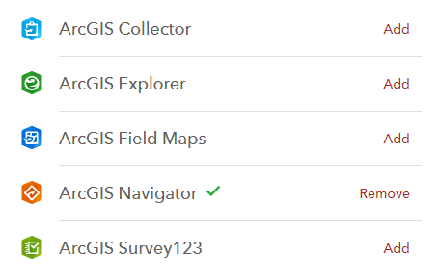
Integration with other apps (default)

Slide 8
Integration with other apps (contd…)
Navigator
Google Maps
Maps (from Apple)
Waze

Slide 9
Assignment Integrations table
No JSON
Use the table to store integrations
Easy to update the table
Fields
App ID
Prompt
URL Template

Slide 10
App ID
arcgis-survey123
arcgis-quickcapture
arcgis-collector
arcgis-explorer
arcgis-navigator
arcgis-workforce
arcgis-trek2there
arcgis-appstudio-player
comgooglemaps
foreflightmobile
waze
spike-partner

Slide 11
Integrating with other apps (URL template)
Platform dependent differences
Use https links (https://survey123.arcgis.app)
Works on iOS and Android devices
Use custom URL schemes where other apps allow linking (arcgis-survey123://)
Works on Android and Windows devices
Add parameters
itemID (itemID=abc123AndRemainingID)
field:fieldname
(field:FirstName=${MySurvey.FirstName}&field:LastName=${MySurvey.LastName})
center (center=47.595953,-122.327954,10)
callback
callback:status (cancel, draft, and submit)
…

Slide 12
Callback parameters from Workforce app
callback
comgooglemaps-x-callback://?daddr=${assignment.latitude},${assignment.longitude}&directionsmode=driving
Custom URL scheme
callback:status (status types - cancel, draft, and submit)
https://survey123.arcgis.app?itemID=FakeIDb809ab8449a9e5f1a7f0676dca9&center=${assignment.latitude},${assignment.longitude}&field:workOrderId=${assignment.workOrderId}&callback:submit=https%3A%2F%2Fworkforce.arcgis.app
Parameters are passed after question mark (?)
Parameters are separated by ampersand (&)
Parameters should be percent encoded for colon and forward slash (: is %3A, / is %2F)
No spaces between parameters , (comma) & ? and =
No itemID should be added in the callback parameter URL (workforce)

Slide 13
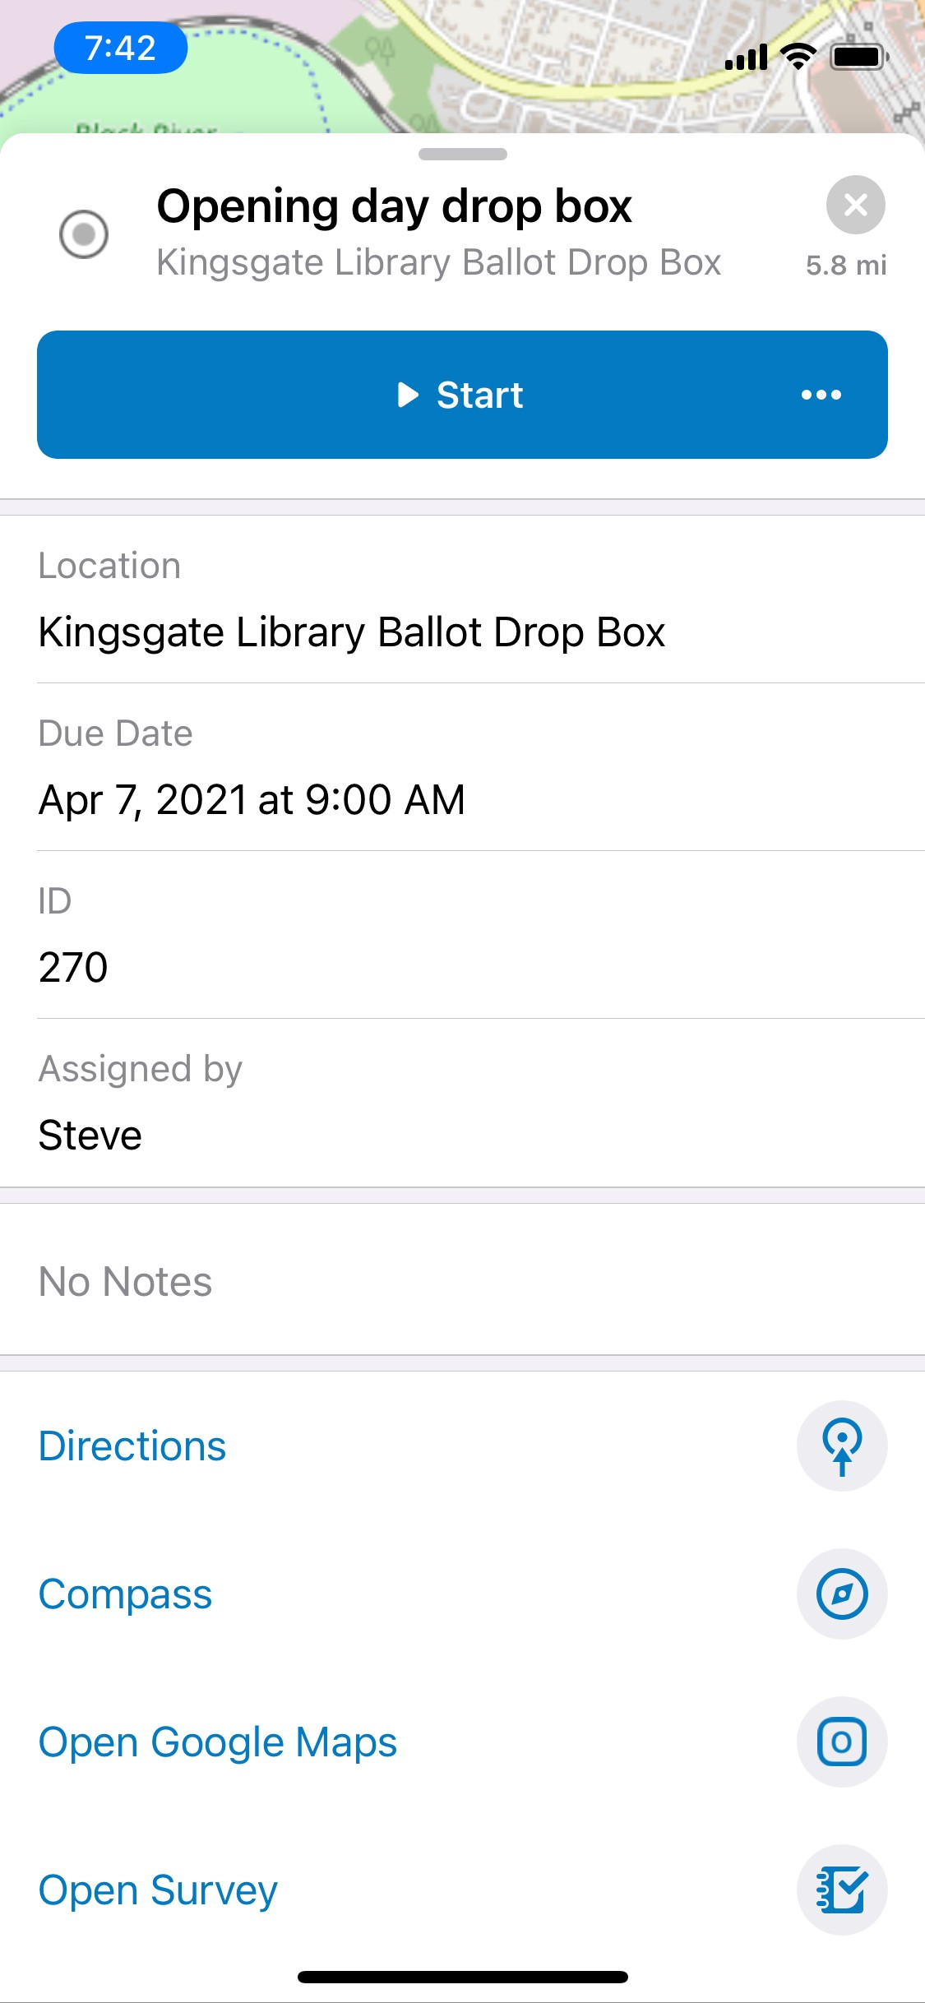
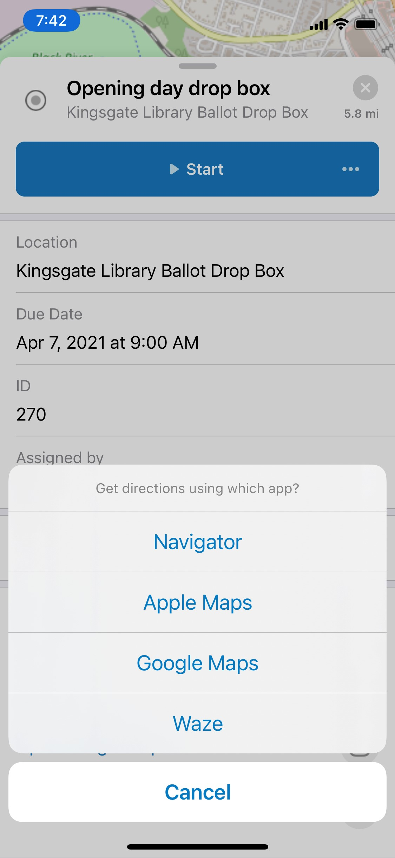
Workforce
Assignment
Workforce
Directions
Apps

Slide 14
Use case
Increases efficiency of the mobile worker
Improves field workflows
Mobile worker can focus on the job on hand

Slide 15
Thank you!!
Harkeerat Kang
Software Engineering GIS, KCIT
Harkeerat.kang@kingcounty.gov

