Slide 1
King County Navigator Training October 6, 2017 Kara Nester, Policy Analyst
Consumer Decision Support Tool/Provider Directory Demo

Slide 2
Consumer Decision Support Tool
Goals of Consumer Decision Support Tool
Help guide consumers to QHPs that are the best match for them
Ease the plan selection process
Response to consumer need
Guiding principles of implementation
Streamlined look and feel for users
Minimize burden on consumers
Ensure accurate, personalized recommendations
User-friendly shopping experience
Consumer tested

Slide 3
Introducing Smart Planfinder
Recommends “Smart Choices” for consumers
Does not filter any plans out of the display
Available in anonymous browsing and in post-application shopping (new and renewing customers)
Available now for 2017 plan shopping. Will be available for 2018 shopping at the start of OE
Features out-of-pocket cost calculator, integrated provider and drug directories

Slide 4
Introducing Smart Planfinder
Features out-of-pocket cost estimator, integrated provider and drug directories
Estimator considers premiums and cost-sharing based on expected utilization of the consumer
Uses formulary data submitted by carriers along with GoodRx data
Uses provider directory data submitted by carriers
Working with a vendor, BetterDoctor, to improve provider directory data

Slide 5
Live Demo

Slide 6
2018 Plan Landscape

Slide 7
Recent Board Activity: Plan Certification
Board certified 2018 health and dental plans on September 25
Materials available at: https://www.wahbexchange.org/event/exchange-board-special-meeting-plan-certification/
Key new issue this year: uncertainty around continued federal payment of cost-sharing reductions (CSR)

Slide 8
2018 Plan Themes
All counties have 2018 QHP options
Premiums increasing because of cost trend and federal uncertainty, particularly enforcement of individual mandate
Deductibles rising
No PPO plans for 2018 plans; market divided evenly between EPO and HMO plans
15 plans offer primary care visits before deductible has been met

Slide 9
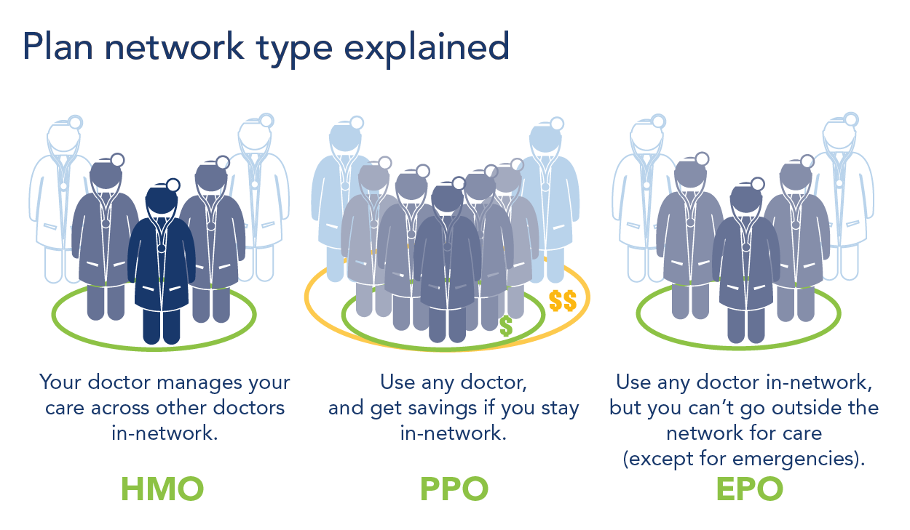
2018 Plan Themes
Notes:
HMO- PCP required
EPO- PCP sometimes required
PPO- PCP not required
HMO- referral required for specialist
No referral required for EPO and PPO
Out of network coverage- Only PPO

Slide 10
Overview of 2018 QHP Submissions
41 individual QHPs approved for 2018
38 renewals, 3 new QHPs
4 issuers offering QHPs in King County:
Coordinated Care, Kaiser Foundation Health Plan of Washington, Molina, and Premera Blue Cross
22 plans in King County
4 Gold
13 Silver
4 Bronze
1 Catastrophic

Slide 11
2018 QHPs by Metal Level
Almost half (46%) of QHPs are silver plans
22% are gold, 27% are bronze
2 carriers not offering bronze plans in 2018:
Molina and Coordinated Care

Slide 12
Approved Deductibles for 2018 in the Exchange
 | Gold
 | 2017 | 2018
Deductible Range | $0 - $1,540 | $0 - $3,800
Median Deductible | $1,200 | $1,250
 | Silver
 | 2017 | 2018
Deductible Range | $0 - $7,150 | $1,750 - $7,150
Median Deductible | $3,000 | $4,500
 | Bronze
 | 2017 | 2018
Deductible Range | $5,000 - $7,150 | $5,000 - $7,150
Median Deductible | $6,000 | $6,350

Slide 13
Accounting for Potential Loss of CSR Funding During PY 2018
OIC has approved and the Exchange Board has certified two sets of rates for each 2018 QHP – one set assuming CSR payments are funded and a second set to account for potential termination of CSR payments to issuers
Secondary rates load the cost of CSR payments onto premiums of silver plans offered inside the Exchange
Rates for gold, bronze, and catastrophic plans are not affected

Slide 14
Implications of Loss of CSR Funding in 2018
OIC has indicated that the second set of rates will go into effect with the termination of CSR payments to issuers
Will significantly increase premiums for unsubsidized enrollees in silver plans
Tax credits will increase as premiums increase for subsidized enrollees
Impact on subsidized population will vary because subsidies are based on individuals’ income, not premiums

Slide 15
Approved 2018 Silver Plan Rates
Carrier | 2017 Approved Rate | 2018 Approved Rate (CSRs Funded) | Percent Increase 0f 2018 Rate over 2017 Rate (CSRs Funded)
Coordinated Care Corp. | $230 | $299 | 30%
Kaiser Foundation Health Plan of WA | $276 | $328 | 19%
Molina Healthcare of WA | $253 | $345 | 37%
Premera Blue Cross | $406 | $481 | 18%
Rates reflect the rate of the lowest-priced Silver plan for a 40 year old non-smoking King County resident in the Exchange.

Slide 16
Approved 2018 Silver Plan Rates
Carrier | 2018 Approved Rate – CSRs Continue to be Funded | 2018 Approved Rate – Federal CSR Funding Ceases | Percent Increase – 2018 CSR Rate to 2018 No CSRs Rate
Coordinated Care Corp. | $299 | $328 | 10%
Kaiser Foundation Health Plan of WA | $328 | $404 | 23%
Molina Healthcare of WA | $345 | $385 | 12%
Premera Blue Cross | $469 | $517 | 10%
Rates reflect the rate requested of the lowest-priced Silver plan for a 40 year old non-smoking King County resident in the Exchange

Slide 17
Next Steps for Plan Certification and Open Enrollment
OIC has approved use of lower set of rates for open enrollment
Preparing for shift, if OIC approves use of second set of rates (due to federal action)
Consumers receive renewal letters by November 1
Outreach to customers to encourage them to shop, compare

Slide 18
Contingency Planning for Loss of CSR Funding
Exchange is developing operational plans to adjust rates, if necessary
Exchange would recalculate tax credits for all subsidized consumers
All consumers would receive a communication
Exchange will work closely with navigators and brokers to provide support and clarification
Exchange is considering offering a special enrollment period

Slide 19
Cross-Mapping
Exchange will re-enroll consumers into their current plan if it is being renewed
~150,000 enrollees
OIC develops methodology for cross-mapping across carriers
~30,000 QHP enrollees’ carrier not offering in their county next year
OIC draft cross-mapping plan prioritizes keeping consumers enrolled in the same metal level plan with the same network type (PPO, EPO, HMO, etc.)
If multiple plans available, maps to lowest cost plan

Slide 20
Dental Offerings for 2018
6 QDPs approved for 2018
Statewide coverage
2 Family Plans
Delta Dental, Dentegra
1 Low/1 High
4 Pediatric-only Plans
Delta Dental, Kaiser NW, LifeWise, Premera
2 Low/2 High
High= Actuarial Value of at least 85%
Low= Actuarial Value of at least 70%

Slide 21
Renewal Timeline
Board certified plans Sept 25
Renewing consumers will receive a letter by Nov. 1 about their 2018 health and dental coverage options
May have the same, similar, or pre-selected plan option for 2018
Outreach to consumers to encourage them to shop, compare, get help in person if needed
Open enrollment begins Nov. 1

