Slide 1
Developing Workforce Strategies for a Guaranteed Basic Income Pilot Program
Andrea Altheimer,
Director of Re-Entry Program
Community Passageways
Andrea@communitypassageways.org
Mike Schwartz,
Director of Economic Advancement
YWCA Seattle I King I Snohomish
schwartz@ywcaworks.org
Gyanendra Subba,
Project Manager
Workforce Development Council
gsubba@seakingwdc.org

Slide 2
Outline
01
Introduction
02
GBI
03
EcSA
04
Customization
Justice Involved Adults Program
05
Money Mechanics
06
CLIFF Tools Demo
07
Program Evaluation
08
GBI Role Play

Slide 3
Guaranteed Basic Income (GBI)

Slide 4
What is GBI ?
A type of ongoing cash assistance program that provides periodcic payments at regular intervals to eligible individuals
It is different from one-time payments like COVID-19 stimulus checks
Eligibility is often based on income but could be based on other factors
Payments are based to eligible individuals unconditionally with no restrictions on how the money is used
For this pilot program, GBI is combined with career development assistance and financial education and coaching.

Slide 5
How does GBI differ from UBI
GBI
Provides a basic income to a specific group of people based on eligibility criteria.
UBI
Universal Basic Income provides a basic income to all residents of a particular community, regardless of any eligibility criteria.
DIFFERENCE
While both address income inequality, GBI is focused on equity and reducing local poverty while UBI is more focused on reducing widespread poverty and is driven by concerns about automation and declining job quality.

Slide 6
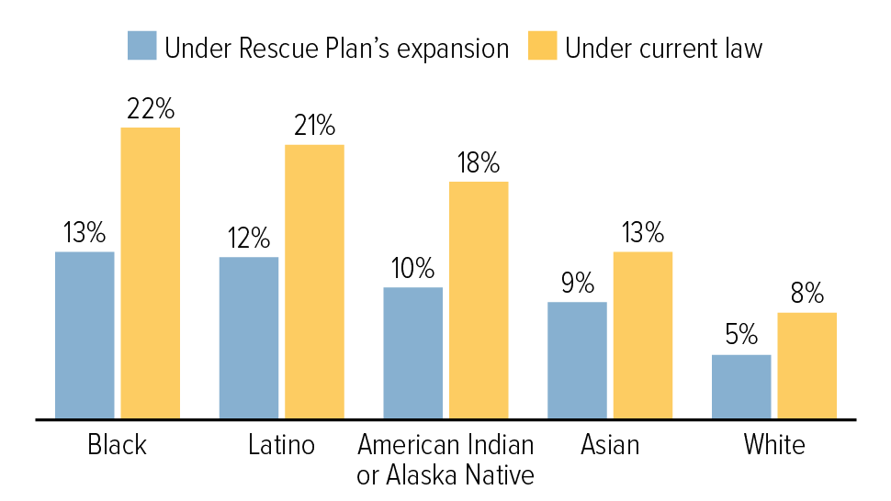
Expanded Child Tax Credit’s Impact on Child Poverty Rates
The monthly child tax credit payments cut child poverty by roughly 30% - NPR (click here)
The CTC demonstrates the success of the guaranteed income model at the national level.
Source: Center on Budget and Policy Priorities

Slide 7
GBI Programs in the US
The Stockton Economic Empowerment Demonstration (SEED) in California is the nation’s first mayor-led GBI program, which provides $550/month to 125 randomly selected low-income residents of high poverty neighborhoods for 2 years.
The Magnolia Mother’s Trust in Jackson, Mississippi is the longest running GBI program, which provides $1,000/month to Black mothers living in affordable housing for 12 months.

Slide 8
Economic Security For All (EcSA)
Uniting Systems to equitably reduce poverty.

Slide 9
Economic Security for All
What
EcSA is an initiative of the Employment Security Department (ESD) intended to prioritize local decision-making and streamline access to existing public services and benefits to support families in moving out of poverty.
Why
26% of Washingtonians living in poverty (200 % FPL) ; fragmented programs don’t serve them well. (King County data)
Who is eligible ?
King County residents over the age of 18 with household income at or below 200 % of the federal poverty level.
WDC Service Provider Partners
YWCA Seattle I King I Snohomish | TRAC Associates
Asian Counseling & Referral Services | Neighborhood House

Slide 10
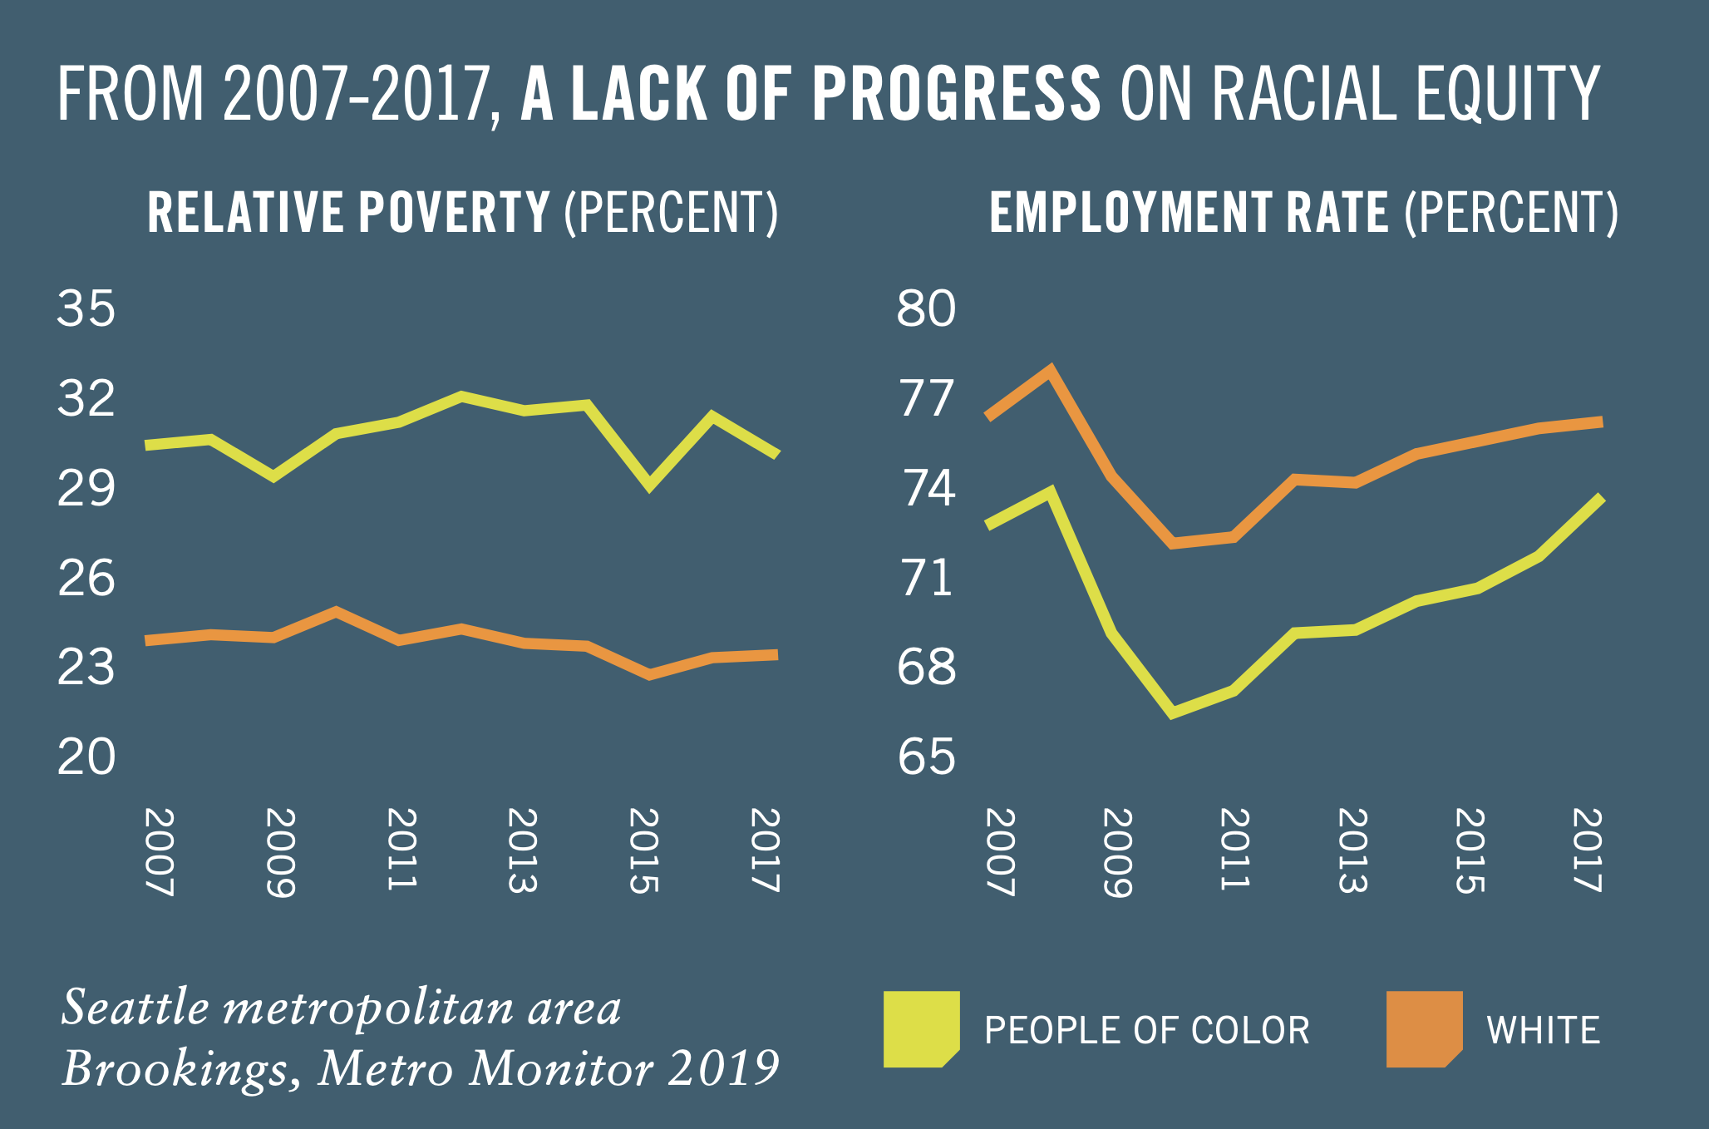
A Lack of Progress on Racial Equity
WDC North Star #1
Equitable Economic Recovery
Recovery as an opportunity to Rebuild Better
Centering Racial Equity
Re-Envisioning Workforce Development
Priority Population
BIPOC, Immigrant & Refugees and other historically marginalized communities like individuals/households experiencing homelessness or impacted by the criminal legal system living in certain zip codes in Seattle & South King County.

Slide 11
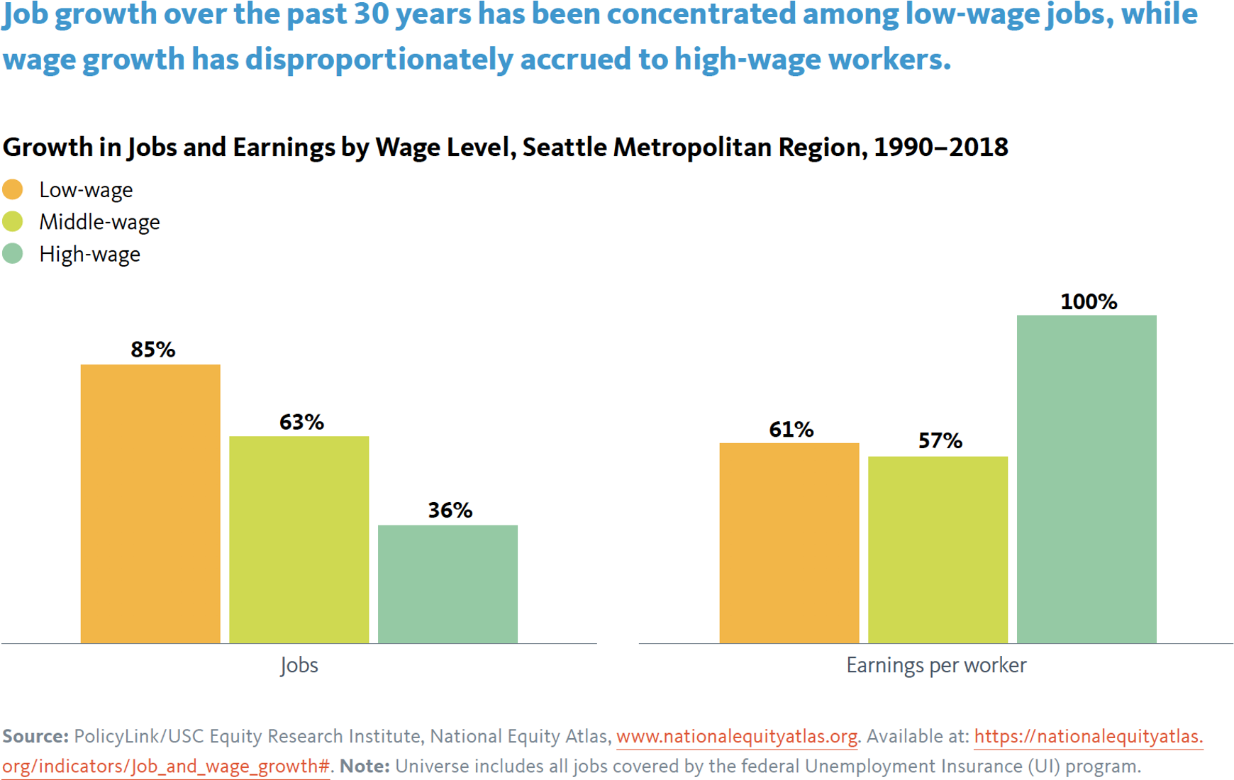
Aggregate Growth Masks Entrenched Inequities
WDC North Star #2
Job Quality
Livable Wage/Family Wage
Benefits
Career Advancement
Workplace Safety

Slide 12
Examples from the news -

Slide 13
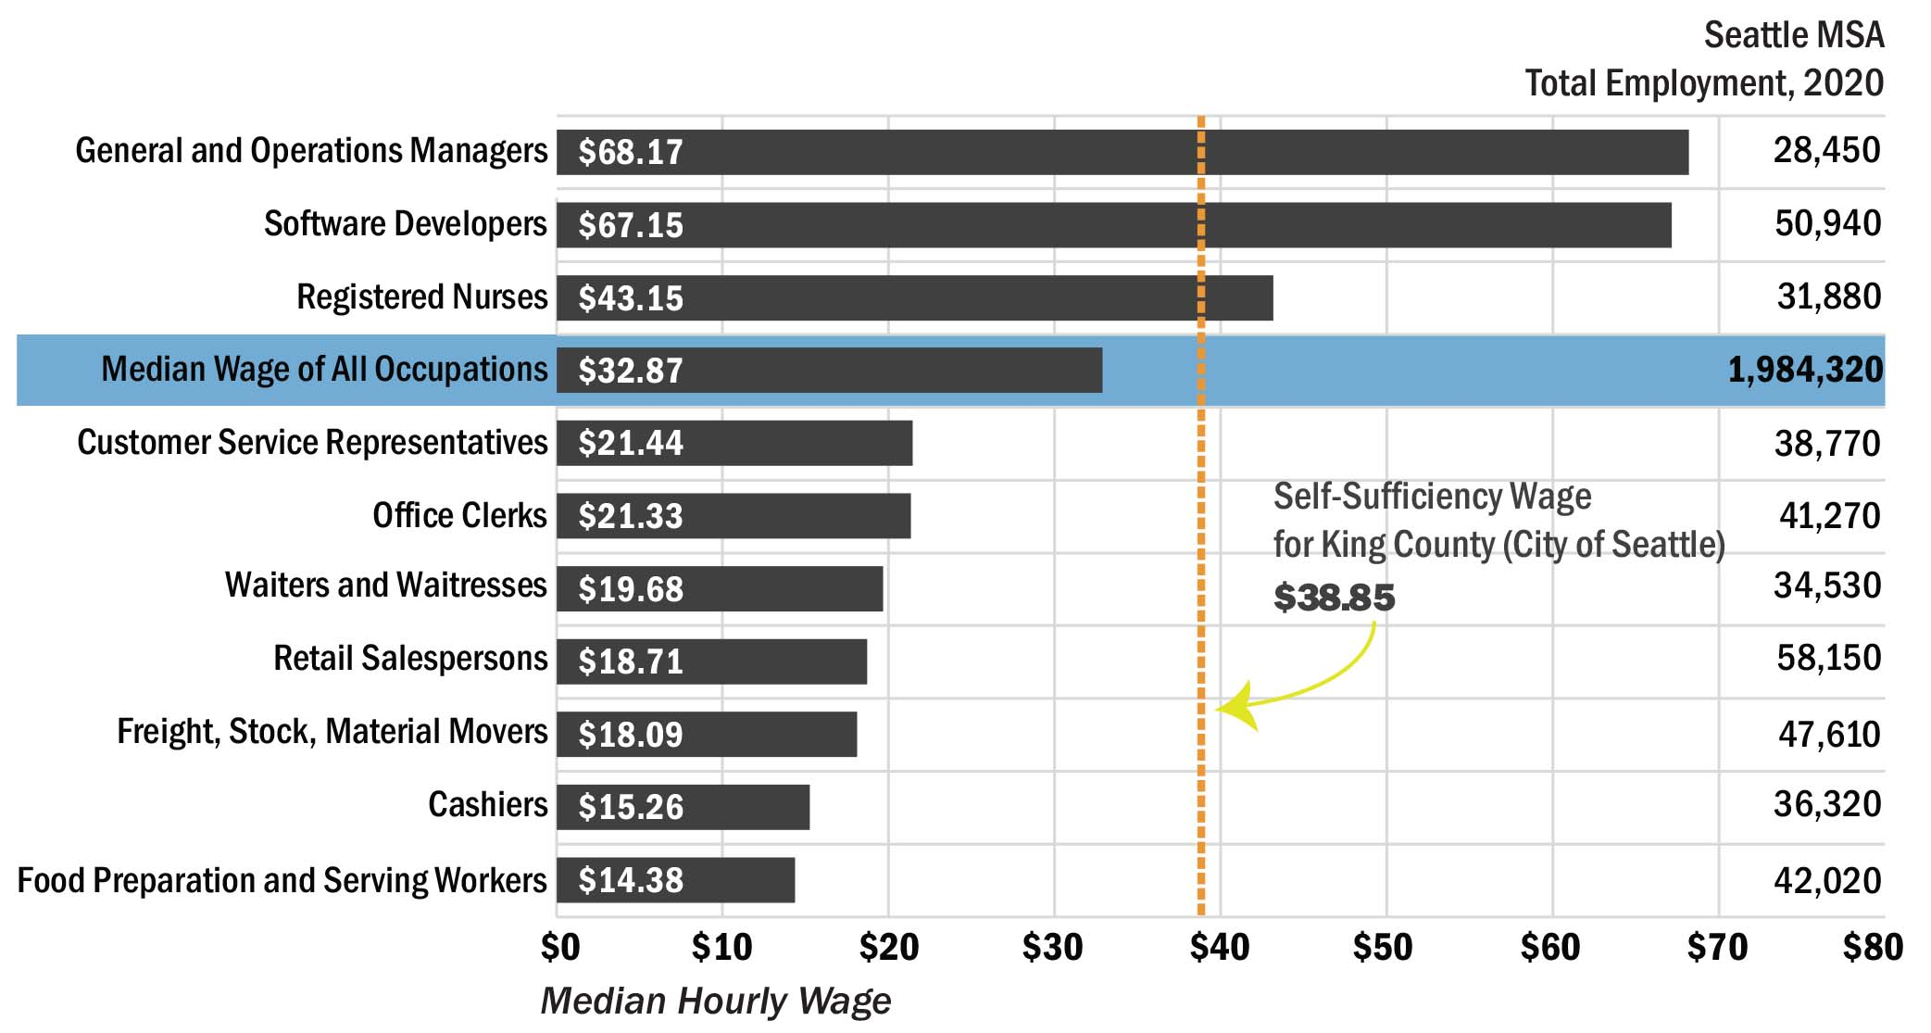
How much do we need to earn to be self- sufficient in King County?
King County (City of Seattle): One Adult & One Preschooler & One School-age Child.

Slide 14
Problem Diagnosis
Benefits Cliff - Benefits cliff occurs when career advancement puts a family above the income eligibility threshold for public assistance and the family is financially worse off than before the wage increase.
Benefits Cliff
Systemic Racism
Poverty
K
K
K
K
Lack of skills/training or skills mismatch
Unemployment
K
K
K
K
K
K
Note: Poverty is complex and has so many other causes and sub causes.

Slide 15
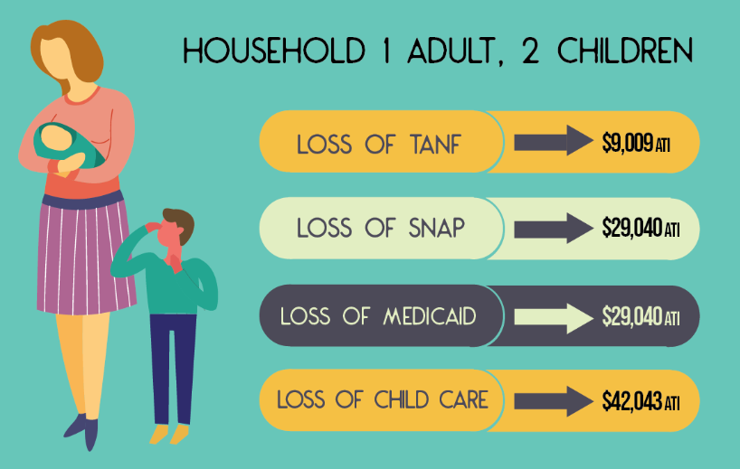
2020 WA Tax Returns AGI
Middle Income
$ 25 K
$ 50 K
$ 75 K
$ 100 K
$ 150 K
$ 200 K
Source: Dept of Human Services- Pennsylvania
Source: IRS

Slide 16
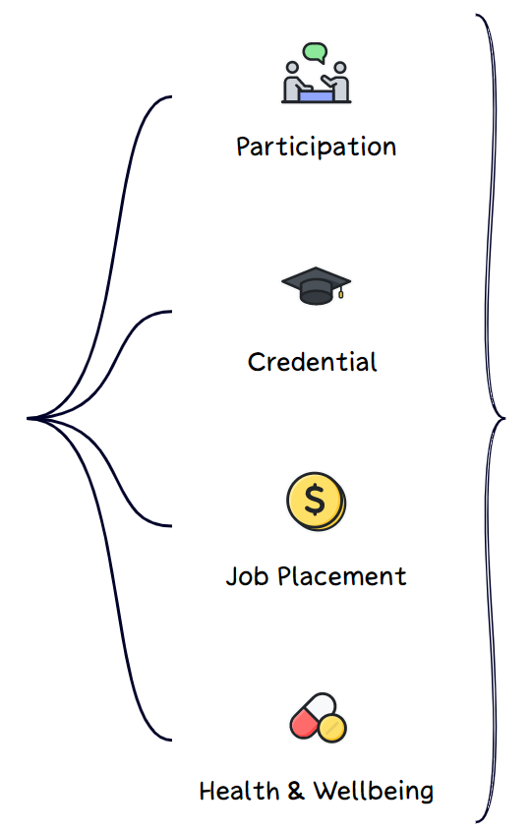
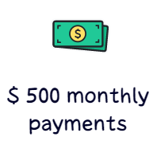
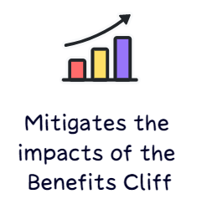
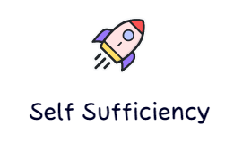
Theory of Change

Slide 17
Logic Model
Inputs | Activities | Outputs | Outcomes | Impact
 |  | The things we do # of participants enrolled # Job placements # of participants completing training programs | Poverty reduction – people becoming self-sufficient Less reliance on the public assistance Tax Revenue Savings Etc.. | Scalable solution for moving more families out of poverty Sustained self-sufficiency through high quality jobs Break the cycle of poverty Equity for BIPOC
Attribution
Contribution

Slide 18
Customization
Employment Supports for Individuals Impacted by the Criminal Legal System

Slide 19
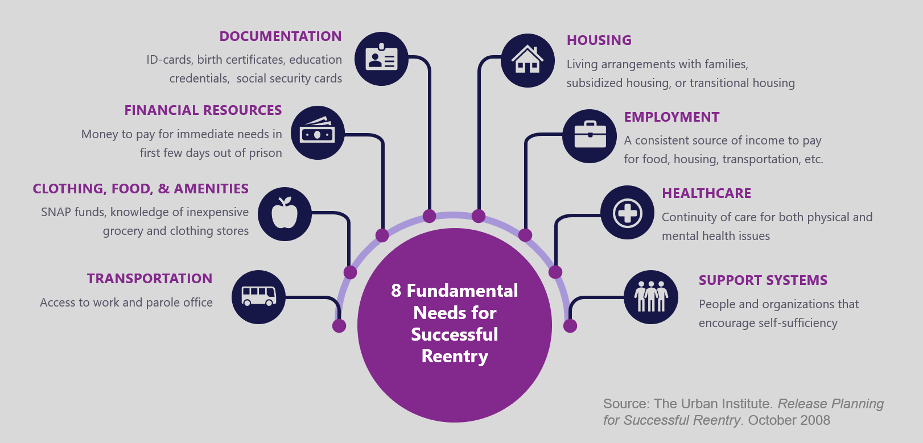
8 + 1 Core Needs for Successful Reentry
# 9 Technology – Digital Literacy Skills
Source: https://totalverify.equifax.com/blog/all-blogs/-/post/why-is-recidivism-so-common-

Slide 20
Successful reentry requires cooperation and efficiency from many government programs
Source: https://totalverify.equifax.com/blog/all-blogs/-/post/why-is-recidivism-so-common-

Slide 21
Financial Education & Coaching

Slide 22
Financial Education
Money Mechanics
A 5-session interactive covering the basics of personal finance topics like goal-setting, banking, budgeting, savings & investing, credit and debt, income tax and insurance.
Supplemental topics include benefits planning, entrepreneurship, healthcare, family law, financial abuse, immigration, housing, and tenant and worker’s rights.
Guest speakers such as bankers and credit repair specialists.
1:1 Coaching
One-on-One Financial Coaching is offered to graduates to help them meet financial goals. Coaching builds on what participants have learned so they can apply their new knowledge to specific situation in their lives.
2:1 Savings Match
Coaching is paired with incentivized matched funds to build savings and credit, reduce debt and reward progress towards financial goals. Coaching incentives are provided at a 2:1 ratio: if a participant saves $200 or reduces debt by $200, YWCA provides a matched incentive of $400.

Slide 23
Benefits
Participants gain a deeper understanding of money management and receive useful financial resources to bridge the gap between knowledge, intentions, and actions
Provides practical tools and resources and empowers participants to take control of their finances
Improves financial well-being and builds financial stability for participants and their families
Financial coaching builds on what participants have learned so they can apply their new knowledge to specific situations in their lives.

Slide 24
CLIFF Tools
Career Ladder Identifier & Financial Forecaster

Slide 25
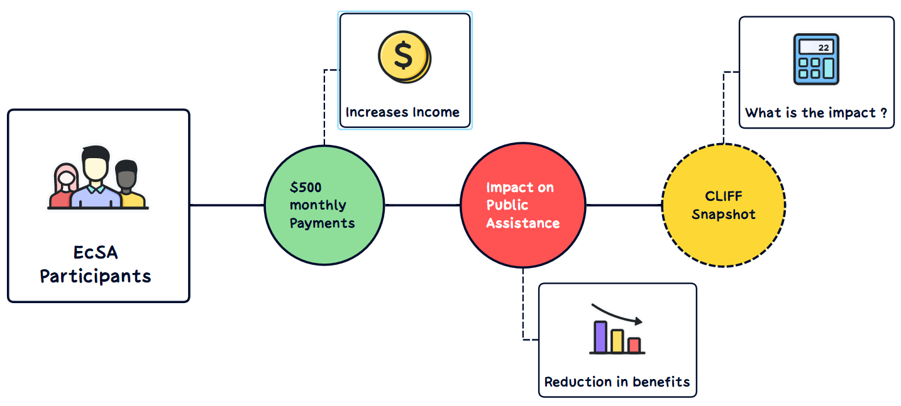
CLIFF Tools – Use Case

Slide 26
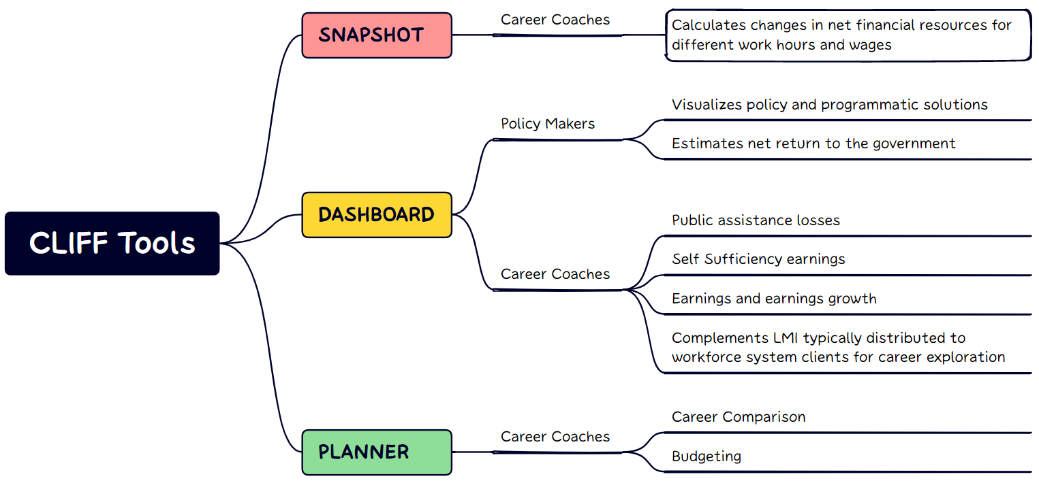
Other available tools
Click here for Snapshot Link
Click here for Dashboard Link
Click here for Planner Link

Slide 27
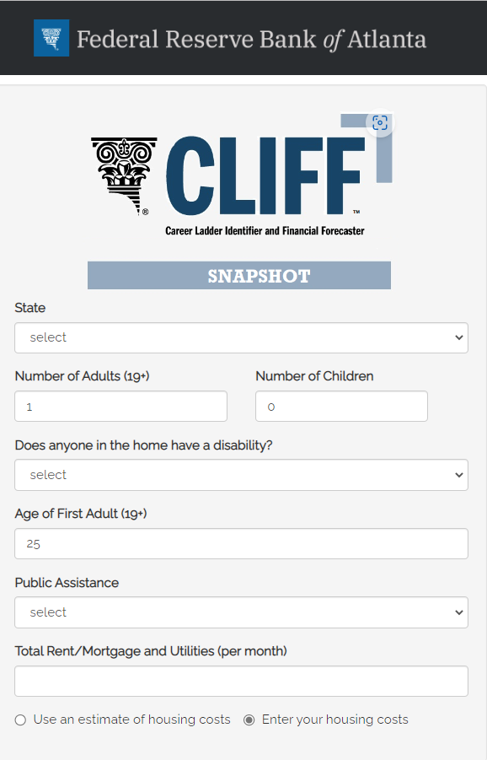
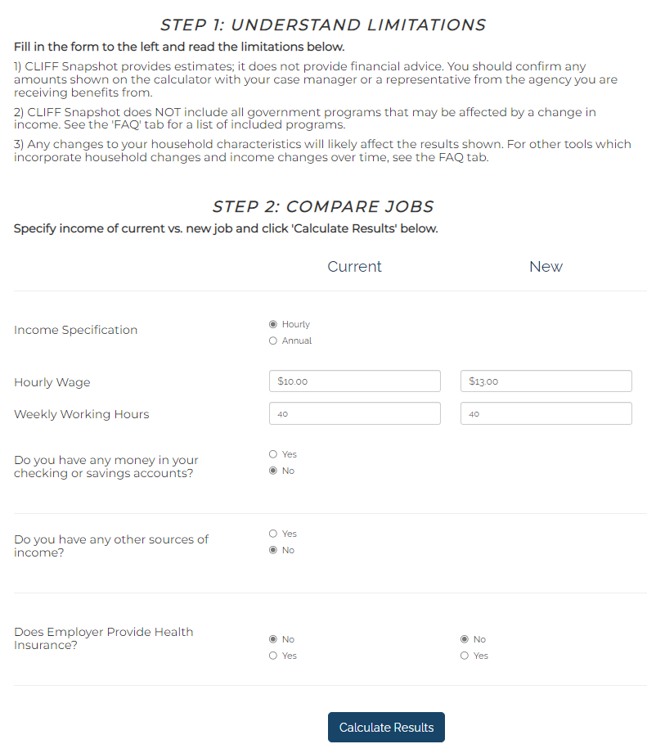
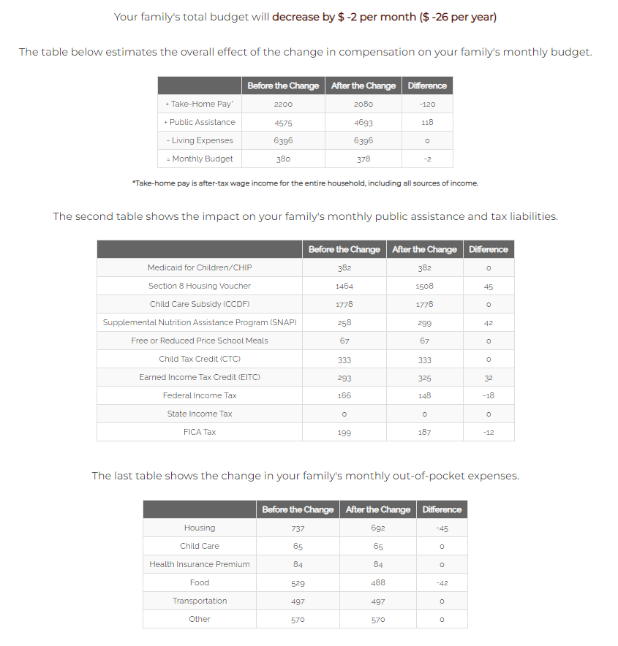
CLIFF Snapshot
Input Data
Report

Slide 28
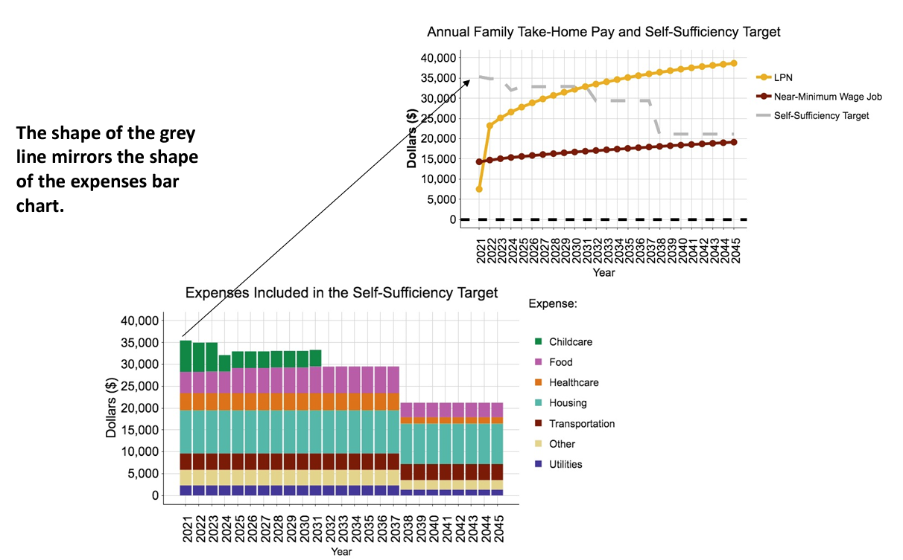
Dashboard Report - Coaches
Self Sufficiency Target –
The amount of income needed to pay basic expenses without the need for public assistance.

Slide 29
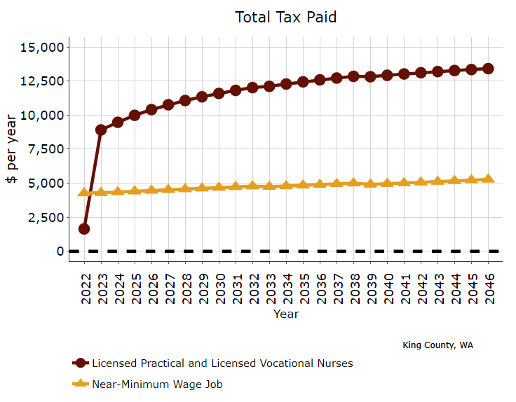
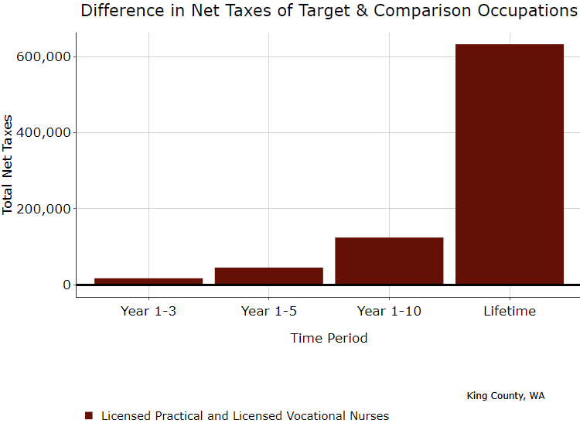
Dashboard Report - Policy Makers
Projected Taxes Along Career Path
Taxpayer Savings to Career Advancement

Slide 30
Program Evaluation
Applied Inference

Slide 31
Mixed Methods Evaluation
Quantitative
Self-Sufficiency Calculator (at entry)
ETO data (at entry)
Mix
Pre-Survey
Focus Group Session 1
Quantitative
Self-Sufficiency Calculator (at exit)
Mix
ETO data (at exit)
Post-Survey
Focus Group Session 2

Slide 32
Role Play

Slide 33
Thanks!
Any questions ?
Andrea Altheimer,
Director of Re-Entry Program
Community Passageways
Andrea@communitypassageways.org
Mike Schwartz,
Director of Economic Advancement
YWCA Seattle I King I Snohomish
schwartz@ywcaworks.org
Gyanendra Subba,
Project Manager
Workforce Development Council
gsubba@seakingwdc.org

