Slide 1
IACS: Indian American Community Services
Connect, Serve, Empower

Slide 2
IACS: Vision & Mission
Vision
Connect, Serve and Empower the Indian American community.
Mission
IACS serves the Indian American community through programs, services for all life stages, while fostering an environment of inclusion and diversity.
Connect, Serve, Empower

Slide 3
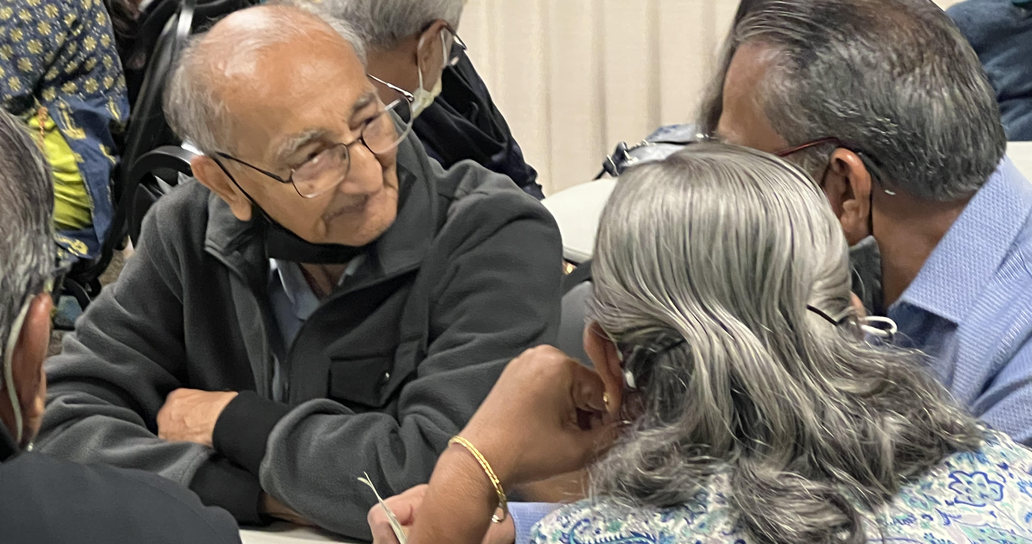

Slide 4
North Bellevue Community Center
Vision
“To support activities and services that enhance the quality of life for our older residents. To encourage ideas and activities that support life-long learning, independence, health, intercultural/ intergenerational connections, and a sense of self-worth.
Mission
City of Bellevue Parks & Community Services Department
“We build a healthy community through an integrated system of exceptional
parks, natural areas, recreation, arts and culture, and a broad base of
community services.”

Slide 7
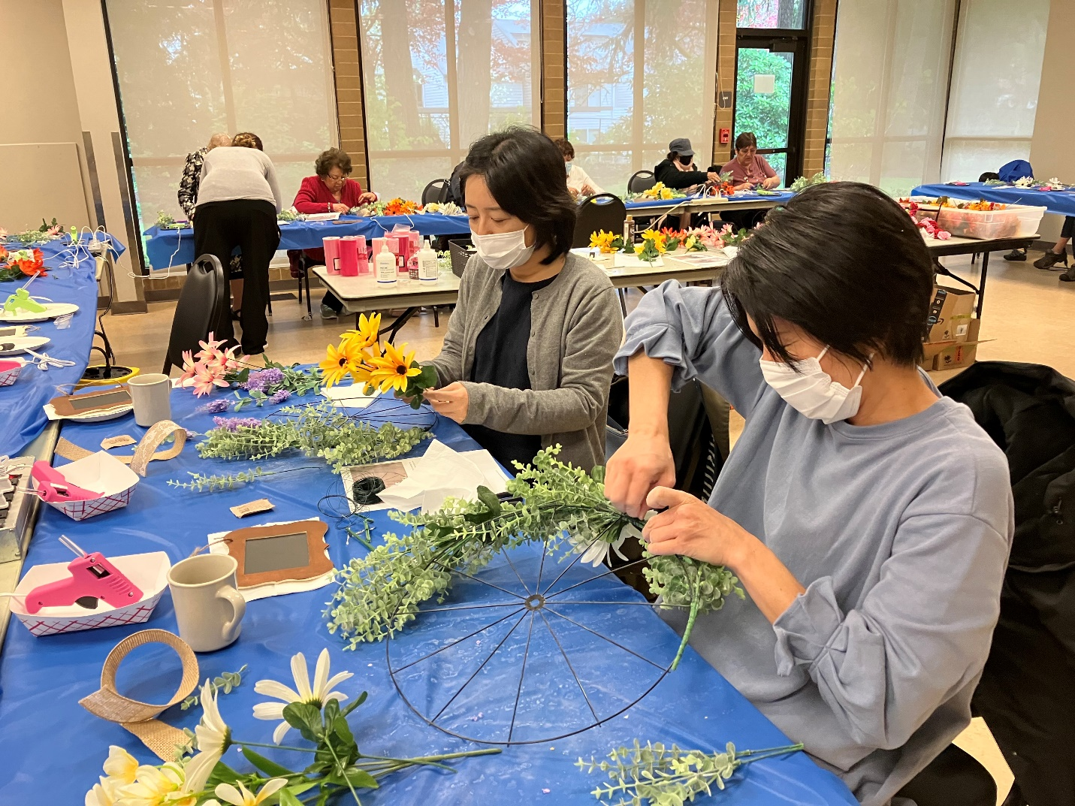
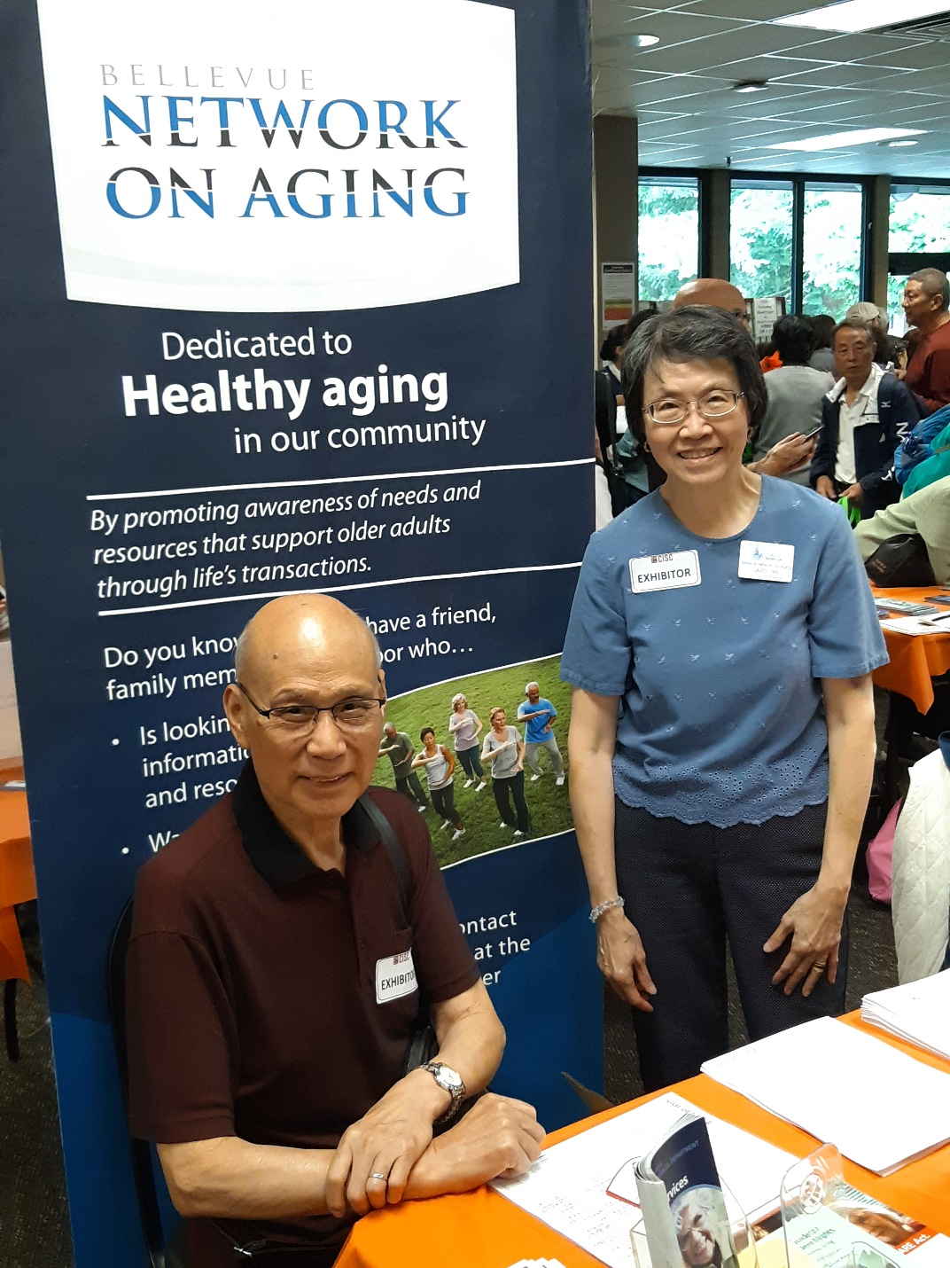

Slide 8
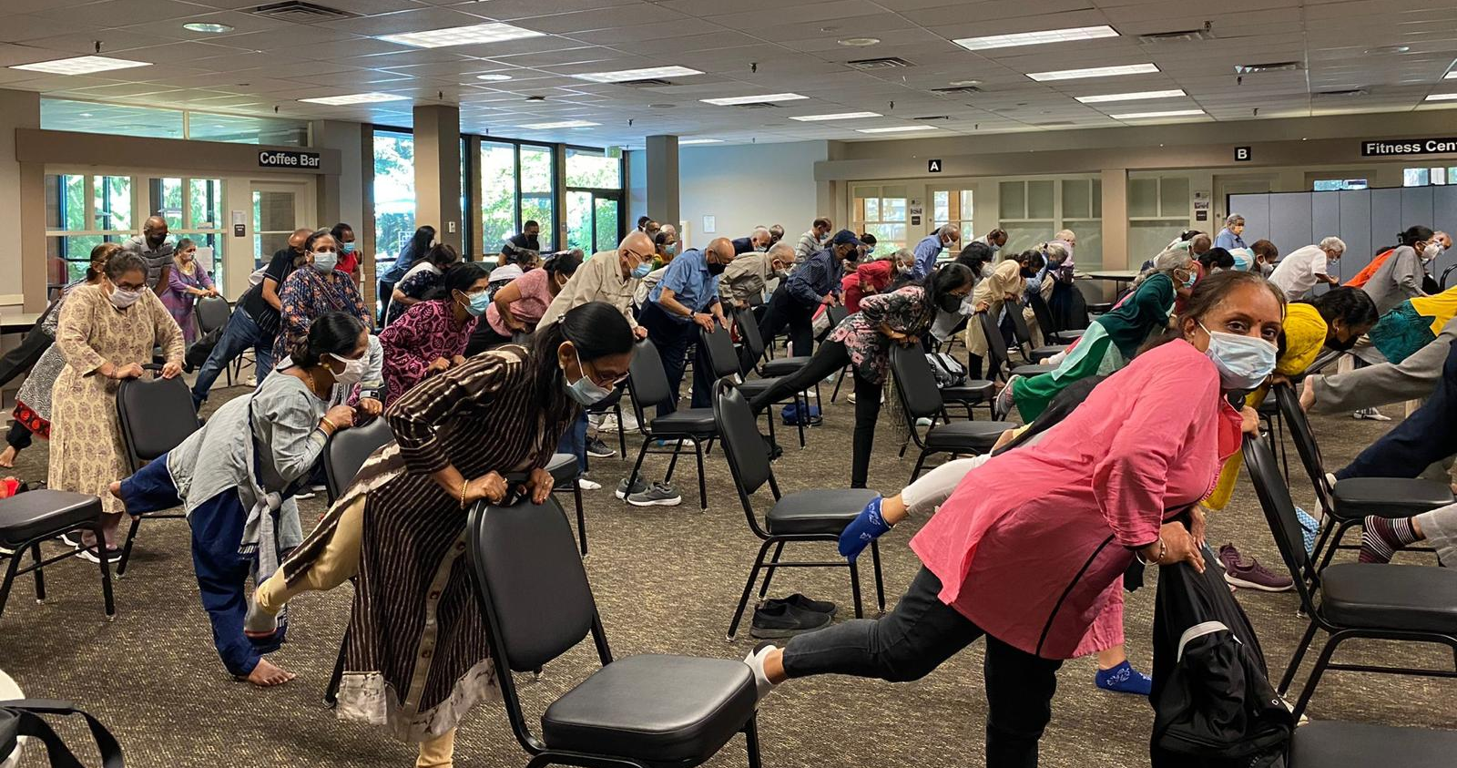

Slide 10
IACS Pop Up Centers
IACS POP UP COMMUNITY CENTERS
North Bellevue Community Center – Thursdays
Northshore Senior Center, Bothell - Tuesdays
Beaver Lake Lodge, Sammamish – Mondays, Wednesdays, Fridays
Kent Commons – Mondays
Redmond Senior Center – Monthly once
Far East Hub – Monthly once
Upcoming
Monthly at MOHAI, Seattle

Slide 12
IACS Centers - Programming
Wellness Program: Yoga, Meditation, Tai-Chi, Strength Training, Gentle Movement & Dance
Community Conversations/Wisdom Cafe: Moderated by Behavioral Health Counselor
Inter-generational Community Meals
Meditative Art Workshops
Game Day, Knitting-Crochet Club, Book Club, Bridge, Holiday Open House
Festive Celebrations
Field Trips

Slide 13
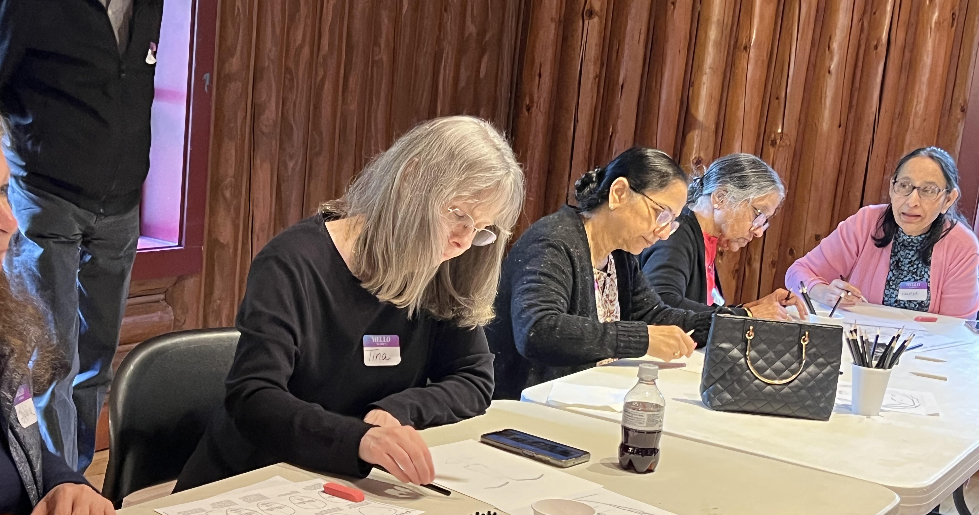

Slide 15
Senior Hubs & Partnering
Access to city operated centers offer grassroots CBOs opportunities to –
- Offer programming, navigation, resource support without the burden of property management
- Easy access to bridging of cultures and communities
- Focus on learnings, programming and resource navigation
Access to culturally friendly meals continues to remain a challenge
- community small business caterers provide culturally friendly food
- engaging our seniors in planning and prepping for meals helps in creating sense of belonging and participation
Flexibility in availability of spaces over daytime and evenings remains a challenge
Reinvent approaches to serve communities – nimble, flexible, impactful

Slide 16
