Slide 1
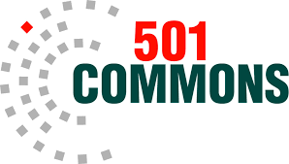
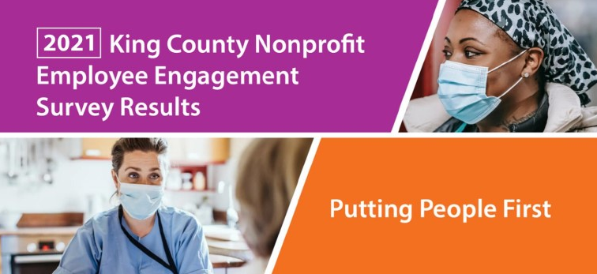
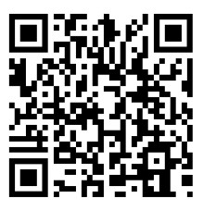
Use your phone or tablet camera and scan this code to download the reports.
Overview of Results
Sam Hampton – Director of Management Consulting and Services
Peg Hunt and Chris Carpenter – Employee Engagement Specialists

Slide 2
Overview of Today’s Presentation
Purpose, background, and methodology of King County Nonprofit Employee Engagement Survey.
Understanding results—what does this data tell us?
Survey results—favorability/unfavorability responses to 59 statements related to Job, Supervision, Client Services, Workplace Culture, and Compensation/Benefit.
What can be done? Recommendations.
Strategies to attract and retain employees.

Slide 3
Background and Purpose
King Country partnered with 501 Commons to conduct county wide non-profit engagement survey along with nonprofit wage and benefits survey.
501 Commons has developed and conducted employee engagement surveys (aka climate surveys) for many years for non-profits forming basis for this survey
Part of the King County Veterans, Seniors, and Human Services Levy
Purpose: to understand how employees engage with their jobs/employers in order to help with attracting and retaining staff, improving employee engagement and satisfaction, and to ultimately produce robust client services.

Slide 4
Interpreting Data and Results
This is a snapshot of perceptions of those who responded to this survey.
Results here are a trailhead or starting point for each organization’s path to better understand employee perceptions and engagement.
All survey results should used in conjunction with other data and information organizations collect
What is our turnover?
Do our staffing levels align with workload?
What feedback have we received from supervisors/managers/staff?
What do our clients have to say?
How does our pay compare to similar organizations?
Survey results are one “piece of the pie” in understanding employee engagement and how organizations meet their mission.

Slide 5
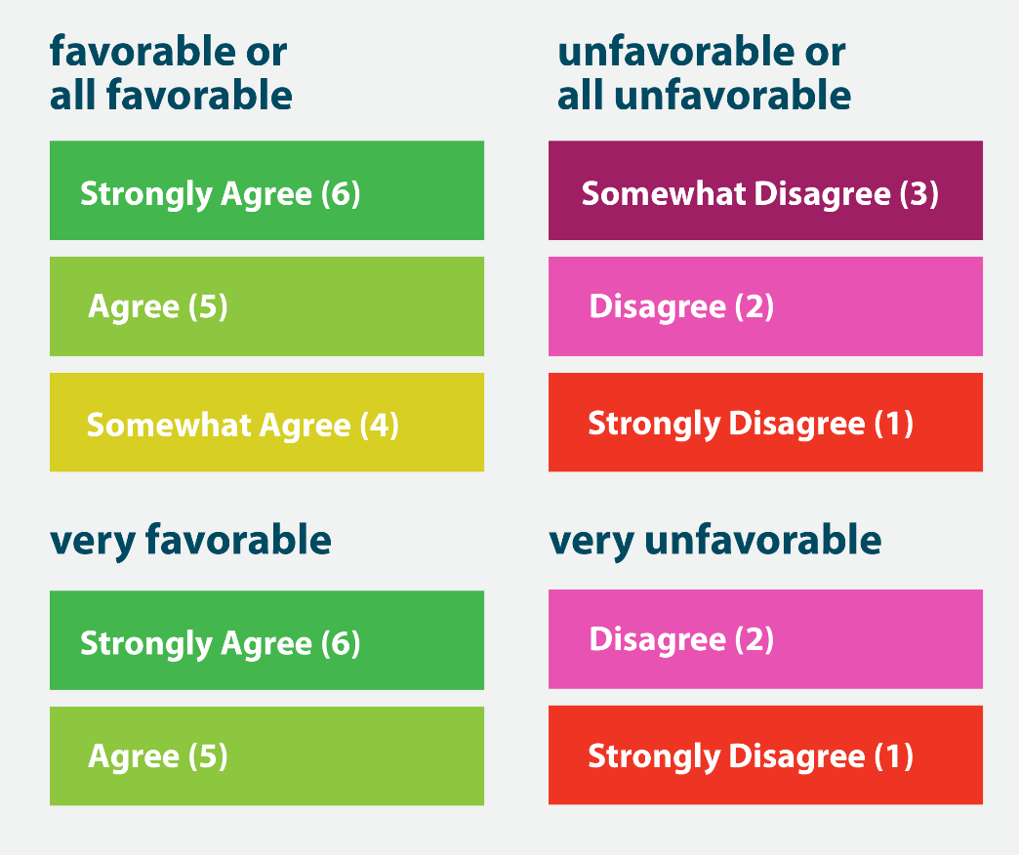
Methodology
501 Commons Engagement survey tailored to King County and stakeholders.
Administered from April 22 – July 11, 2022.
1200 participants from 263 organizations.
Organizations <5 to over 1,000.
Demographic questions, tenure, commute times, organization responses to COVID.
Limitations and strengths to this survey.
*Favorability Ratings of 6-point Likert Scale

Slide 6
Demographics
Gender:
72% were female, 19% male, 5% nonbinary, 4% preferred not to say.
Race:
Similar to census data from King County; 70% white, 14% Asian, 8% Black/African American, 4% self-describe in another way, 2% American Indian/Alaska Native, 2% Native Hawaiian/Pacific Islander.
Sexual Identity:
58% ID as heterosexual or straight, 11% bisexual, 11% queer, 9% prefer not to say, 8% gay or lesbian, 3% self-describe differently.
Age:
17% are 20-29, 28% are 30-39, 18% are 40-49, and 20% are 50-59, and 12% are 60 and older.

Slide 7
Individual Organization Reports Available
If your organization had 5 of more survey respondents, request an individual survey report for your organization by contacting info@501commons.org.
Subject: “Employee Engagement Survey.”
You will be able to compare data from your staff with the full King County results.
Use your phone or tablet camera and scan this code to download the reports.

Slide 8
Results – Overall Favorability/Unfavorability
Overall Favorability for All Questions:
86% - All Favorable
14% - All Unfavorable

Slide 9
Most Favorably Rated Statements
98% agree that they know how their job contributes to the organization’s mission.
97% agree that clients feel that my organizations/programs services are valuable.
96% agree that their supervisor allows flexibility during their workdays.
It is inspiring that nonprofit employees reported favorable responses that are unusually high for similar surveys, despite all the stress, risk, change, loss, and trauma they experienced since March 2020.

Slide 10
Most Unfavorably Rated Statements
I feel my organization actively recruits and hires applicants with disabilities .
(41% unfavorable)
I am being paid equitably, relative to similar jobs in our sector.
(36% unfavorable)
My supervisor discusses opportunities with me for career advancement.
(32% unfavorable)
What can be done?
Hiring transparency & explicit hiring objectives—let people know what your goals are and what you are doing about it.
Make compensation system fair, audit salaries, and make transparent.
Annual performance reviews should include career development and opportunities.

Slide 11
Dimension Details
Client Services: is the most favorably rated - this is why employees often work in nonprofits. A strong connection to the mission is a crucial factor in retaining employees.
Job: Respondents understand their role and its contribution to mission. Within this, there was less favorability around adequate equipment and technology and reasonable workloads/caseload. Listen and respond to what employees need.
Supervisor: Respondents positive about supervisor providing flexibility, showing respect, and acknowledging contributions. There was less favorability to the statement - “My supervisor discusses opportunities with me for career advancement.”

Slide 12
Dimension Details
Workplace Culture: covered communication, fair treatment, feeling valued, decision-making practices, and hiring practices. There was less favorability around clarity of decision making, actively recruiting and hiring those with disabilities.
Compensation and Benefits: was the least favorably rated dimension, with items related to compensation the least favorable & benefits rated more favorably.

Slide 13
Dimension Ratings
Client Services - Participants feel very positive about their organizations' ability to meet client needs. (95% favorable) (Celebrate that employees see that you are meeting your mission!)
Job - How they understand their role in the organization and how their job contributes to the mission. (90% favorable)
Supervisor - Supervisor providing flexibility, showing respect, and acknowledging contributions. (90% favorable)
Workplace Culture - Communication, fair treatment, and feeling valued, to decision-making and hiring practices. (83% favorable)
Compensation and Benefits - Equitable pay and benefits. (80% favorable)

Slide 14
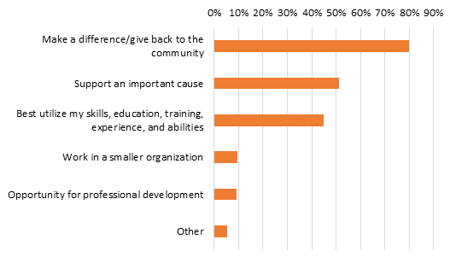
Attracting and Retaining Employees
Top Reasons People Work in Nonprofits
What can be done?
Communicate how you make a difference.
Link employee performance to how the organization makes a difference.
Link performance evaluations & job descriptions to meeting mission.
Identify best ways to utilize staff skill and background.
Celebrate what employees bring.
Discuss avenues for growth and development.

Slide 15
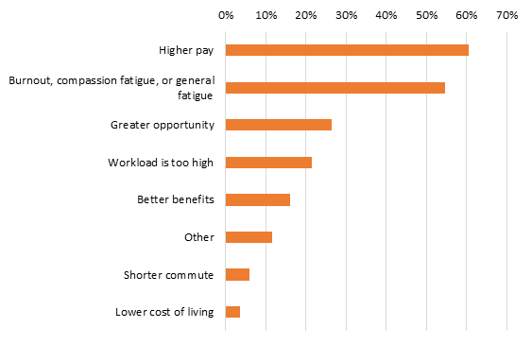
Attracting and Retaining Employees
Top Reasons People Leave Nonprofits
What can be done?
Pay is a challenge but ensuring that salaries are equitable within (pay compared to similar others) and sector (compared to salary survey), ensure salary pay policy is transparent and equitable.
Address workload issues: evaluate staff workload & adjust.
Address workplace stress and burnout—outside support, activities that support health and wellness, listen to employee concern and show that you are acting based upon input.

Slide 16
COVID-19 Response: What made it more difficult to work from home?
The sense of isolation and lack of contact with coworkers is very significant.
What to do?
Support and increase creative ways of interacting remotely.
Keep up those Zoom meetings. (but in productive and targeted ways—just like any in-person meeting)
COVID-19 Response: Actions taken to make it easier to work from home
Given the isolation, it is fortunate employers were able to provide greater connection with others and reduce some isolation through Zoom or other virtual meetings.
Ask employees-what are other ways to reduce isolation and increase connection?

Slide 17
COVID-19 Response: Communication and Safety
Employees were generally favorable about employer responses to COVID-19.
Celebrate the strength and resiliency of these non-profits.
Continue to update and evolve policies related to working from home, planning for the “next” workplace interruption, reward employees for their responses to tough situations.

Slide 18
What’s Next?
Thanks to all who participated in the survey and encouraged their employees to participate.
Participate in 2023!
Next:
501 Commons HR Consultant Chris Carpenter:
Actions managers and supervisors can take to address employee engagement and retention.

Slide 19
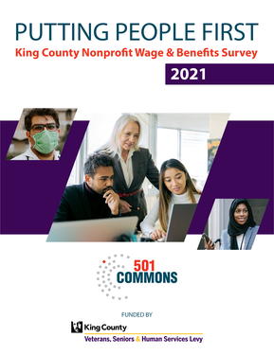
Employee Engagement and Retention
Employee retention relies on a combination of factors, including:
Flexible work arrangements.
Better pay and benefit.
Professional development opportunities.
Advancement opportunities.
Organizational culture.
While salary plays a role in employee engagement, the good news is that it isn't the star player.
In addition to working to raise additional funds to improve salaries, organizations should:
Clarify your compensation philosophy.
Benchmark salaries to similar nonprofits using the King County Nonprofit Wage and Benefits data. (501commons.org/resources/putting-people-first)
Ensure that salaries are internally equitable and compliant. with the Washington State Equal Pay and Opportunities Act.
Make compensation processes and policies transparent.
Download for free the King County Nonprofit Wage & Benefits Survey Report, a resource that can help you set fair wages, recruit and retain talented employees, and strengthen our ability to serve our communities. Visit the 501 Compensation Tracker so you can easily compare compensation data from several job titles.

Slide 20
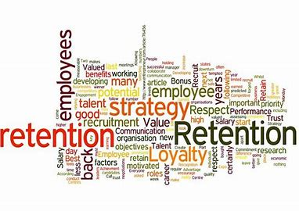
Focus on Retention
Executives and HR professionals are reporting that employee retention is their top challenge, closely followed by recruitment.
While recruitment will continue to be a challenge given the pay and benefits levels in the sector, it is critical that you focus on retention.
Turnover is high in the general economy
2021: 25% voluntary turnover. (57.3% overall.)
Turnover in the nonprofit sector is tends to run higher than other sectors.
Hiring transparency & explicit hiring objectives—let people know what your goals are and what you are doing about it.
It is much less expensive to retain a productive employee than it is to recruit one.

Slide 21
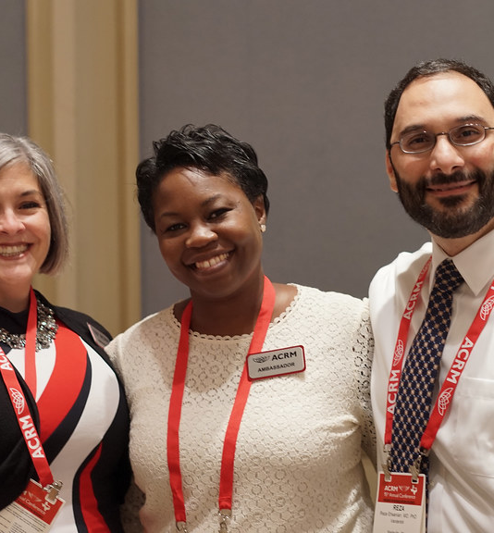
Who is most at risk?
Employees who have been in the same role for a long time may feel they need to leave an organization to advance their career.
Productive employees want to advance in their career. They are motivated by the prospect of promotions, and the chance to take on more challenging work.

Slide 22
Make sure managers are not compelling employees to leave
Behaviors employees do not like about their managers.
There are blatant transgressions
Paying favorites
Making inappropriate advances
Making informal threats
There are also more subtle reasons an employee leaves their manager.
A lack of development opportunities
Not feeling appreciated
Feeling micromanaged

Slide 23
Make sure managers are not compelling employees to leave
How can managers and supervisors pinpoint the biggest pain points for employees and proactively address them?
Collect input and feedback regularly.
This is more than an annual performance appraisal, or a weekly check in.
Climate Surveys are a great way to gauge how employees are feeling. This survey was based on the 501 Commons climate survey.

Slide 24
Build a culture of recognition to increase employee appreciation
Invite managers and employees to post appreciative comments or write personal notes to their colleagues recognizing what they did well and explaining why it was important.
Present the recognition publicly to broadcast a colleague's accomplishments.
Create annual (or more often) awards where recognized employees are honored in front of their peers and senior management.
Above all, make sure to celebrate and reward behaviors the organization wants to encourage.

Slide 25
Questions?

Slide 26
https://www.501commons.org/resources/putting-people-first
Sam Hampton – Director of Management Consulting and Services, samh@501commons.org

