Slide 1
Economic Opportunity and Empowerment Advisory Board
October 8, 2015
Apprenticeship Access Strategy

Slide 2
Process:

Slide 3
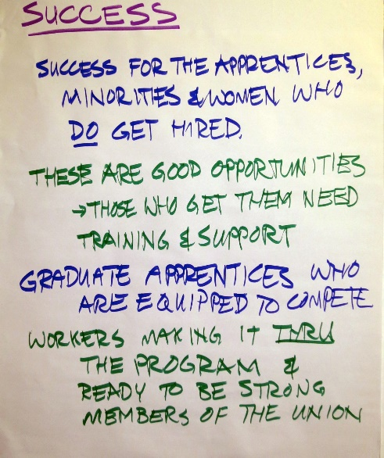
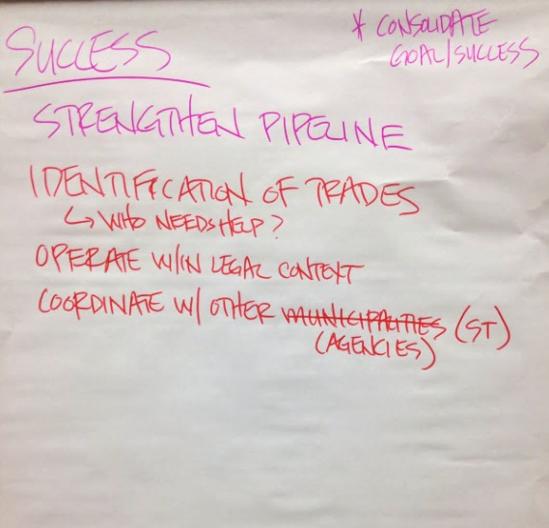
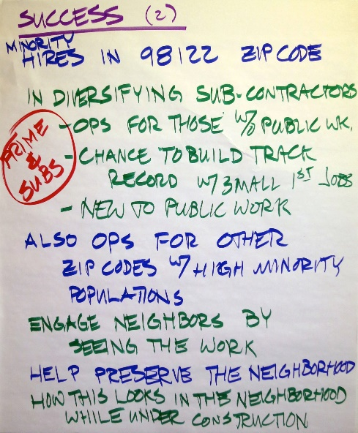
Meeting #1 – Aug 26: Desired Outcomes from EAB (discussion)
Success for the apprentices, minorities, and women
Training and support
Graduate apprentices equipped to compete
Workers are strong union members
Hires in 98122 & other zip codes with high minority populations
Diversify subcontractors
Opportunities for those without prior public work experience
Lead to first jobs in Public Works projects
Engage neighbors by seeing the workers that look like them
Help preserve the neighborhood
Neighborhood perception of the construction project is important
Diversity reduces risk

Slide 4
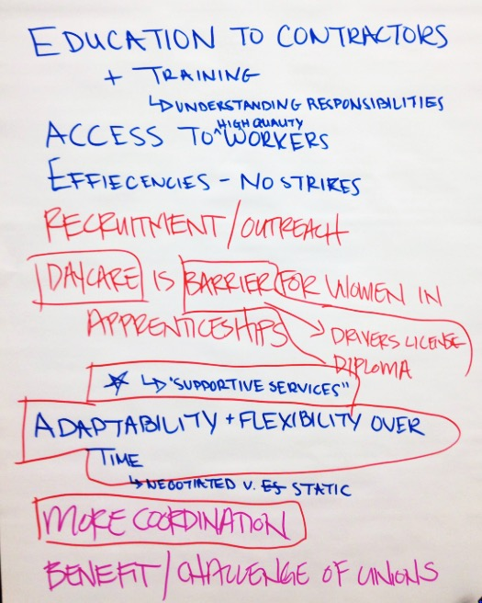
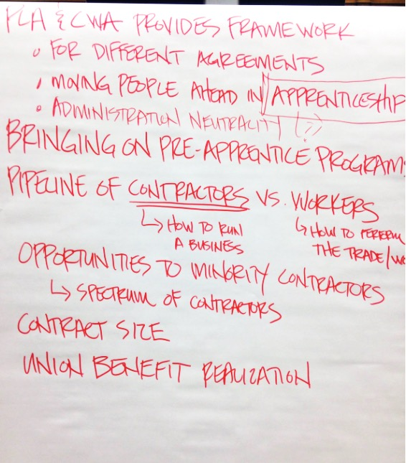
Meeting #2 – Sep 10: Community Workforce Agreements
How do CWA elements impact your stakeholders?
Supportive issues and barriers to access:
Driver’s license
GED
Child-care
If a PLA is less than a year non-union workers who pay in do not see the benefit.
Workers who may be trained but aren’t union can also have hard time entering the union.
Union’s need to keep quality of trained force, which drives their restrictions for new workers entering.

Slide 5
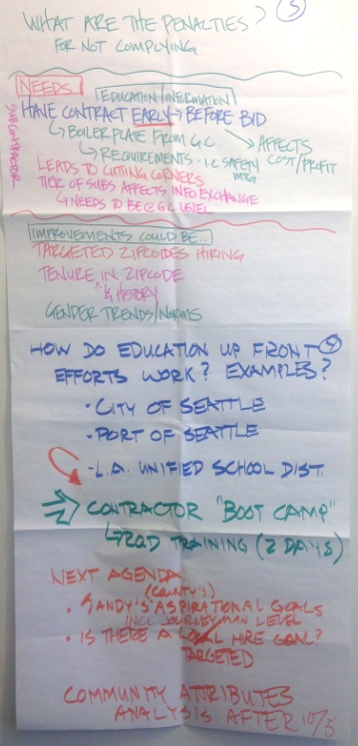
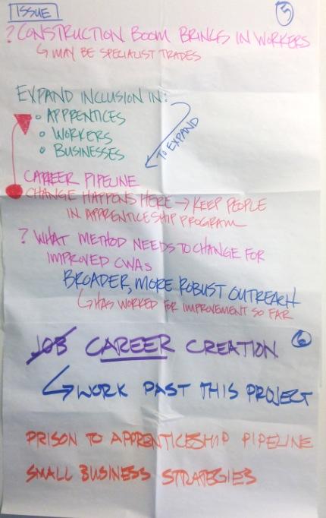
Meeting #3 – Sep 24: Contractor Inclusion Strategy
Can the plan make inclusion stronger?
What priorities do EAB stakeholders need from education elements?
TIMING: Subcontractors to know components of the PLAs and CWAs well in advance
GC provides subcontractor information before contract signing
COST: small contractors believe there are extra costs that make PLA projects infeasible
OUTRACH: County role in outreach and as a resource for contractors for requirements
Mix of responsibility between the different involved agencies
EVALUATION: Best intentions may not lead to desired results - track and adjust as needed
QUESTIONS: Outreach… Structure? …Responsible parties? Who is missing?

Slide 6
Desired Outcomes from the EAB:
TRAINING AND SUPPORT: Ensure success of apprentices, minorities and women who are equipped to compete and diversify the workforce (diversity reduces risk)
OUTREACH TO TRADES: Identify and support trades that need the most help in diversifying their workforce
UNION PARTICIPTION: Workers have the opportunity to be strong union members
ACCESS TO JOBS: Strengthen the pipeline to Public Works & other opportunities for those without prior work experience by making the opportunities widely available & accessible
LOCAL HIRES: Increase hires in zip codes with high minority populations
NEIGHBORHOOD PRESERVATION: Preserve the neighborhood with a positive perception of the construction project that engages workers that look like them
IMPLEMENTABLE: Ensure the CWA fits within the context of complicated legal framework

Slide 7
Apprenticeship Access Strategy
Scaling Opportunity in the PLA environment

Slide 8
DEFINITIONS:
Registered Apprenticeship (RA) Established State recognized earn while you learn training:
Meets recognized Department of Labor standard for RA and is “in good standing”
Combines in classroom instruction with OJT
Pre-Apprenticeship Training program recognized by the State designed to prepare participants for RA
Established relationship with at least one RA program
Meets completion rate standards set by King County

Slide 9
Value of Apprenticeship Access and Utilization
Local and regional economic growth comes from an increase in the tax base contributions of having an employed skilled workforce in the region.
Economic Development
Increase in career access for low-income workers, women, veterans, people of color, and other disadvantaged workers.
Employment Opportunities
Connect workforce with career OJT and in-classroom training that leads to industry recognized certifications and licensing.
Educational Opportunities
Provide contractors with access to a trained, qualiﬁed workforce.
Skilled Workforce
Small Business Participation
Increase capacity of small minority- and women-owned businesses and develops their pool of available workers through their internal work standards.

Slide 10
What are the existing CFJC program criteria?
Apprenticeship Utilization Criteria Contractor must meet the minimum of 15% utilization in accordance with KC law
Contractor Agreed to goals for CFJC Project
20% minority contractor inclusion
17% Apprenticeship Utilization
Aspirational Goals
21% Minorities
25% Women
2% Disabled
7% Disadvantaged Youth

Slide 11
Inclusion Grows through Stakeholder Education
All parties agree to support Registered Apprenticeship and Pre-Apprenticeship throughout the life of the CWA:
Purchaser
Contractor
Unions
This also requires a commitment to additional stakeholder education – Public, Leaders, Etc.

Slide 12
Key Elements in Apprenticeship Access Strategy
Contractor engagement
Working partnerships
Project Expectations
Available Resources

Slide 13
Job Access Through Contractor Engagement
Focus must remain the On time and On Budget Project Delivery
Participation in Pre-Apprenticeship job placement process
Minimum impact to operation, easy engagement through the dispatch system
Workers prioritized in accordance with PLA guidelines
Focus on use of disadvantaged workers
Consistent verifiable reporting

Slide 14
“I have found no greater satisfaction than achieving success through honest dealing and strict adherence to the view that, for you to gain, those you deal with should gain as well.” Alan Greenspan
Working Partnerships

Slide 15
Pre-Apprenticeship Pipeline Integration
Create an eligible pool of workers through pre-apprenticeship partnerships
Design access through third party coordination (internal/external)
Facilitate worker eligibility verification
Provide for contractor and RA approval
Establish process for support resource access
Coordinate apprenticeship relationship

Slide 16
Apprenticeship Integration
Requires contractor education
Project Requirements
How to gain access to Apprenticeship (dispatch request)
Crew composition mix (percentage level based on skill/cost)
RA program engagement
Dispatch engagement
Establish third party compliance (internal/external)

Slide 17
Support Resources (for programs)
Resourced point of contact for the agency
Collaborative program resources
Support for coordination across programs
support for verification
Service resources
Program delivery
Ancillary support

Slide 18
Support Resources (for workers)
Information
Eligibility and Expectations
Key Points of Contact
Coordination across established agency services/external support services
Material support
Tools
Transportation
Childcare

Slide 19
Discussion
Questions or concerns about King County’s apprenticeship efforts in CFJC project? Can the plan make them stronger?
What priorities do your stakeholders need to see that are not reflected in plan approach?

Slide 20
Economic Opportunity and Empowerment Advisory Board
October 22, 2015
Oversight and Compliance Approaches

