Slide 1
Department of Judicial Administration Superior Court Clerk’s Office
Electronic Court Records: The King County Experience
Snohomish County Clerk’s
Electronic Court Records Management System
Superior Court Stakeholder Meeting
September 16, 2011
Presented by:
The Honorable Michael J. Trickey, Superior Court Judge
Barbara Miner, Superior Court Clerk
Teresa Bailey, DJA Deputy Director

Slide 2
King County ECR Experience
Department of Judicial Administration
Having a Vision,
Providing Leadership and
Championing the
Electronic Court Records Program
Barbara Miner, King County Clerk
Notes:
Session Title

Slide 3
Vision, Leadership, Championing the ECR Program
Department of Judicial Administration
Session Agenda
King County Superior Court & Clerk’s Office
Ash Award Sponsor: ECR Program Overview video
The Master Plan and ECR Projects
KC ECR Program: What Makes the Success
Notes:
This is the session Agenda

Slide 4
King County Superior Court & Clerk’s Office
Department of Judicial Administration
Court Locations: Seattle, Kent, Juvenile, Harborview
53 Judges / 13 Commissioners
215 Clerk’s employees (including Courtroom Clerks)
75,000⁺ new case filings in 2010
Approximately 7,000 documents received per day
Notes:
Briefly to relay the size of the court and number of documents flowing into the clerk’s office.
Explain the case assignments and schedule process (i.e. – caseload and “active pending” number)

Slide 5
Considering an Electronic Court Records Program
Department of Judicial Administration
Why: We had problems: volume, access, space & budget issues
Who: We had visionaries & leaders: supportive Court, Clerk & community
What: We wanted to serve customers better; recognized a technology solution
How: We realized a phased approach & funding opportunities
Notes:
The early years…
Setting the stage for the Video

Slide 6
ECR Program in King County
Department of Judicial Administration
2007 Innovations is American Government Award
“ The King County Electronic Court Records Program demonstrates the power of collaboration to fundamentally improve the judicial process.”
Stephen Goldsmith, Director
Innovations in American Government Program
Ash Center for Democratic Governance & Innovation
Harvard’s Kennedy School of Government
Notes:
Acknowledge Award sponsorship: purpose to share the King County experience with others

Slide 7
Harvard’s Award Grant
Department of Judicial Administration
Share the King County Experience
Supported speaking engagements
Online Library of program materials & info
http://www.kingcounty.gov/courts/ECRlibrary.aspx
ECR Video highlighting program
Notes:
National and international interest
Grant funded efforts
Created the video to highlight the program and collaboration

Slide 8
ECR Program in King County
Department of Judicial Administration
“Justice Denied? Not in Seattle”
Visionaries Series - Changing the World, One Story at a Time
http://www.youtube.com/ashinstitute#p/search/1/SOjhpI3Jb10
Notes:
As part of the Ash Institute Award Grant, a 15 minute KC ECR Program video was created by Visionaries Inc. and posted on YouTube, shown on PBS Stations around the nation and on our local KCTV. You are welcome to share the video with others.
Visionaries Inc. is a nonprofit organization dedicated to using the power of media to tell stories of the people and organizations making positive social change throughout the world. Their goal is to use media and education to change people's lives.

Slide 9
ECR Program: How KC Built It
Department of Judicial Administration
Local government funding, ownership, control
Local ownership of the record
Custom built by one vendor
Extensive involvement by those who use it most & stakeholders
Local Project based on State/National standards
The Master Plan guided the way
Notes:
Overview

Slide 10
The ECR Master Plan
Department of Judicial Administration
States the mission, vision, goals & strategies
The Electronic Court Record will be the official record of the court
Defines project management structure, stakeholder involvement & communications plan
Divides the vision into manageable stand-alone, independently successful phases
Notes:
Master Plan: Laid out where we were going. Helps all read the same page of music. Links the project to the mission of the court or clerk
Defines the management structure of the project. Defines our stakeholders. Clearly describes roles for each committee. Decisions put on paper for all to see – the vision: electronic court record will be the official court record. Document used as a solid base – referred back to throughout the project as not to re-debate issues
Divided the VISION into small, manageable, stand-alone phases
Separately funded
Separately structured, separate goals
Separately successful
Separate return on the investment
Key to success of the project.

Slide 11
ECR Program Timeline
Department of Judicial Administration
2000 ECR Core: Clerk’s Electronic File Management System
2002 ECR Viewer Application; ECR is the Official Court Record
2005 eFiling and ECR Online Applications
2009 Mandatory E-Filing for Attorneys
1998 ECR Program Master Plan; Document Imaging
2011+ Enhancements, eForms, ECR Core Rewrite

Slide 12
Phase 1: Core ECR
Department of Judicial Administration
Clerk’s Office Internal File/Document Management System
Electronic workflow processing for staff
Expanded worksite location flexibility
Increased security of sensitive documents
Routing & process history captured in activity log
Notes:
The ECR video showed a glimpse of the Core ECR application and process, which routes document files on electronic workflows that consist of one or more work steps to ensure accurate and complete processing.
Indexing is the process of linking the electronic image with a case number and identifying the sub number.
Quality checks verify the image quality, case caption, filed date, comparing page numbers, orders signed, etc
The security of sensitive documents and cases is maintained by specialized roles that are assigned using administrative tools that are built into the application.
For quality assurance purposes – history documented on activity log

Slide 13
Phase 1: Core ECR
Department of Judicial Administration
Integrated electronic docketing with WA State system
Pushed into SCOMIS: sub #, file date, SCOMIS code
Pulled into CORE ECR: description of code

Slide 14
Phase 2: ECR Viewer
Department of Judicial Administration
Connectivity:
Internal electronic record access via a browser
Public viewing of court records in clerk’s office
Court access: courtroom, chambers, court staff
Law, Safety & Justice partners access via KC Wide Area Network

Slide 15
Phase 3A: ECR Online
Department of Judicial Administration
Internet access to court records
Web application
Fee-based, draw-down account
View, copy, print documents
Restricted case type access per KCLGR 31
Notes:
Will talk more about LGR 31 later

Slide 16
Phase 3B: Electronic Filing
Department of Judicial Administration
Electronic filing over the internet
Free for non-fee filings
Initiate new cases; file into existing cases
Judicial filings with digital signatures
Special processes & expansion capabilities
County’s eCommerce application for filing fees
Notes:
Teresa will expand on this further this afternoon

Slide 17
Why We Built it This Way
Department of Judicial Administration
Necessity
Strong sense that it would benefit everyone; Used that to build the constituency
Budget constraints and staff constraints; couldn’t do it all at once
Intuitive & evidence basis for projections
Saw other models that didn’t make sense to us

Slide 18
Project Funding
Department of Judicial Administration

Slide 19
What Makes ECR a Success
Department of Judicial Administration
Electronic records are official
RCW 36.23.065
(3) … Electronic reproductions are acceptable media for this purpose if one of the following conditions exists:
The electronic reproductions are continuously updated and, if necessary, transferred to another medium to ensure that they are accessible through contemporary and supported electronic or computerized systems; or
The electronic reproductions are scheduled to be reproduced on photographic film, microphotographic, photostatic, or similar media for indefinite preservation.
Notes:
Not maintaining dual systems – agree to print when necessary

Slide 20
What Makes ECR a Success
Department of Judicial Administration
State & Local Court Rules
Incredible efficiencies
Increased document quality & record security
Systems interactions & expansion capability
Specialized functionality based on KC needs
Notes:
Mindful considerations went into the development of rules – revisions to LR
Resource savings in the Clerk’s office
QC processes / security / e-filing document quality improvements (clean, readable, color photos…)
Screen scrape – data push / pull between applications; enhancements (ex parte via the clerk; eForms – in court electronic orders)
Applications support and enhance business processes

Slide 21
What Makes ECR a Success
Department of Judicial Administration
Stakeholder Gains:
Quicker turnaround – document filing to access
Simultaneous access to the court file
Remote / all hours access to case records
Time & resource savings

Slide 22
King County ECR Experience
Department of Judicial Administration
Having a Vision, Providing Leadership and Championing an
Electronic Court Records Project
Questions?
Notes:
Next up, Judge Trickey will give you his perspective of the project, transition and ECR today in our court.

Slide 23
King County ECR Experience
Department of Judicial Administration
Electronic Court Records
and the Court:
A Judicial Perspective
Hon. Michael J. Trickey, Superior Court Judge

Slide 24
ECR: A Judicial Perspective
Department of Judicial Administration
Session Agenda
Pre/Post ECR in King County Superior Court
Collaboration: Project Planning Involvement
Open Court Provision
Bringing Judicial Officers Along
Notes:
Quick run through of your session topics

Slide 25
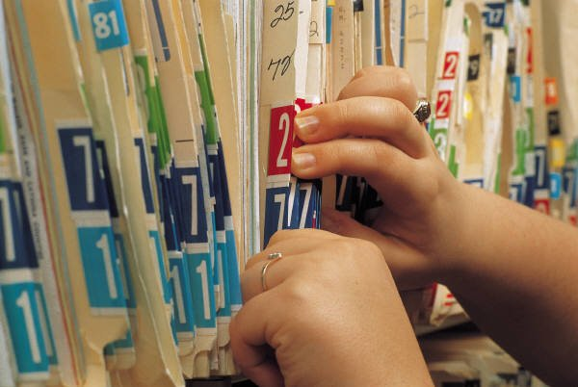
Electronic Court Records
Department of Judicial Administration
Pre ECR in King County
Files, files everywhere
Delays & access issues
Post ECR in King County
Increased efficiencies & flexibility
Even on the worst days…. It’s so much better than paper!
Notes:
Confirm comments in video - Briefly expand.
This is what the judicial officers in the room want to hear – what is your experience.
Give some examples – tell a story

Slide 26
Collaboration in Planning
Department of Judicial Administration
Be Involved Early
Court’s Technology Committee
Form Ad Hoc Committees - address issues as they arise
Agree to exceptions and schedule reviews
Service Level Commitments / Protocol
Notes:
From your experience…

Slide 27
Open Courts Provision
Department of Judicial Administration
Washington State Constitution
ARTICLE I
DECLARATION OF RIGHTS
Section 10 Administration of Justice. Justice in all cases shall be administered openly, and without unnecessary delay.

Slide 28
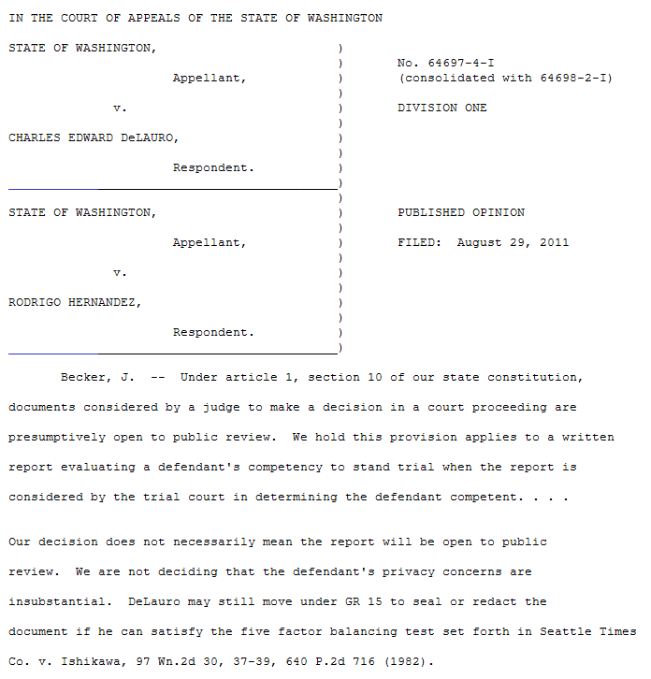

Slide 29
General Rule 31 Access to Court Records
Department of Judicial Administration
“ The public shall have access to all court records…”
“… applies to all court records, regardless of the physical form of the court record, the method of recording the court record or the method of storage of the court record.”
Notes:
Judge Trickey – please let me know if you would rather have different quotes.

Slide 30
Open Court Provision
Department of Judicial Administration
Open Courts and Court Records Promote:
Accessibility to Everyone
Transparency
Public Trust in Judiciary
Accountability

Slide 31
Why ECR is Good for Judges
Department of Judicial Administration
Promotes confidence in the integrity of the record
Preserves the record from loss, theft, water & fire damage
Facilitates easy access to the record
Allows simultaneous multi-use of the record
Documents are available much sooner

Slide 32
Why ECR is Good for Judges
Department of Judicial Administration
Enhances knowledge of the case history & enables better decision making
Permits flexible work hours
Resource savings for the county and filer
Makes transmittal of the record for appellate review easy and quick

Slide 33
Why ECR is Good for Judges
Department of Judicial Administration
Promotes a seamless process
Proposed order submitted electronically
E-file the digitally signed order
Promptly distribute the signed order via email
Electronic review of working copies

Slide 34
Bring the Judges Along
Department of Judicial Administration
Involve Judicial Officers early – pro technology and not
Make the case for the change – build buy in
Listen to input – pressure points become clear
Build trust & establish an environment of success through pilot projects

Slide 35
Bring the Judges Along
Department of Judicial Administration
Stair-step implementations: phase in to ease stress
Plan for success by gaining inches, not feet: prove incremental successes
Recognize a variety of technology comfort levels: provide support
Communicate, communicate, communicate

Slide 36
What’s in it for me?
Department of Judicial Administration
Notes:
Probably need to ask Judge Robinson first if we use this slide ☺

Slide 37
King County ECR Experience
Department of Judicial Administration
Electronic Court Records
and the Court:
A Judicial Perspective
Questions?

Slide 38
King County ECR Experience
Department of Judicial Administration
A Change in Business:
Change Management
and
Electronic Court Records Today
Barbara Miner & Teresa Bailey

Slide 39
A Change in Business
Department of Judicial Administration
Session Agenda
Legislative: State & Local Court Rules
Communications: Critical for Support
Connectivity: The Transition to ECR
Changed Operations: Clerk’s Office
Return on Investment: ECR Today
Notes:
Barb

Slide 40
Washington State Rules
Department of Judicial Administration
GR 31 Access to court records
GR 15 Sealing, redacting & destruction of court records
GR 22 Family law & guardianship cases restricted access & confidential reports
GR 30 E-filing, digital signature, hours, fees, e-Service by agreement
Notes:
Barb
Conflicting Philosophies:
One Tier: If it’s accessible at the courthouse, it should be accessible remotely. If it is accessible in paper it should be accessible electronically.
Two Tier: Litigants have historically relied on the “practical obscurity” of records filed at the courthouse. Certain court records should only be available at the courthouse even thought the records are considered “public”.
Years of debate & discussion, public hearings and meetings, workgroups and public comment.
Conclusion: Washington has a long history of open access to public records – apply to remote access to court records.
Privacy is Protected:
Redaction and Omission of certain personal identifiers GR31 (e)
No public access if court records are restricted by “federal law, state law, court rule, court order or case law”. GR 31 (d)(1)
GR 15: Court must make written findings that specific sealing or redaction is justified by identified compelling privacy or safety concerns that outweigh public interest in access. Court record should not be sealed when redaction will adequately resolve issues.
GR22: Reports in family law or guardianship cases shall be filed as two separate documents, one public and one sealed.
Public: includes a simple listing of materials reviewed, individuals contacted, test conducted or reviewed, conclusions and recommendation. Sealed: Detailed descriptions and analysis filed under a coversheet designated “Sealed Confidential Report”. EX: parenting evals, DV assessment reports, CPS reports, risk assmts, GAL / CASA reports, Sexual abuse evaluations.
GR30: Electronic filing authorization; Signatures – S/, multiple signatures, “under penalty of perjury”; Receipt by the clerk hours; OK to charge fees, make sure to allow for waiver for indigent filing – Access to Justice Issues.

Slide 41
Local Court Rules
Department of Judicial Administration
LGR 31 Online access to court records
Cases filed November 1, 2004 & after
All criminal cases (case type 1)
All civil cases (case type 2) except DV & anti-harassment protection orders
All probate cases (case type 4) except guardianship cases
Notes:
Barb
Who was involved -- Discussion and thoughts behind creation

Slide 42
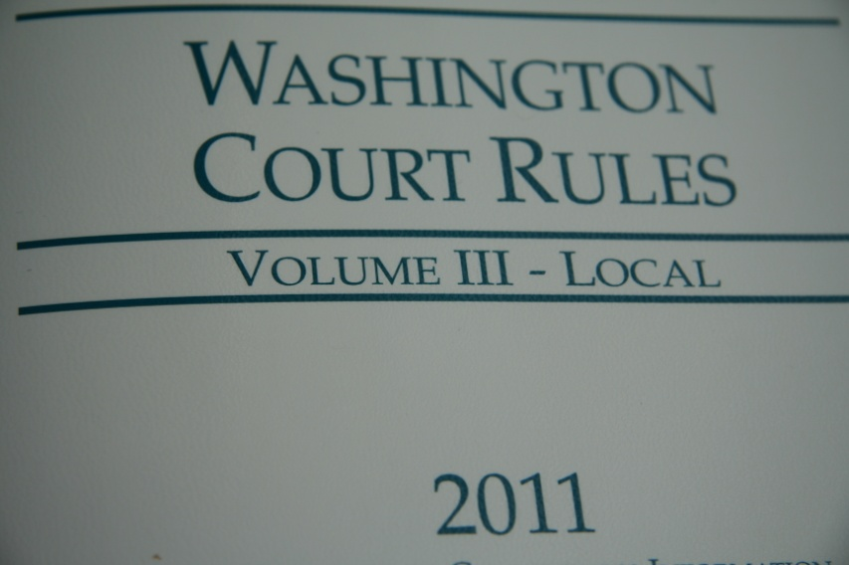
Local Court Rules
Department of Judicial Administration
LGR 30 Mandatory e-filing for attorneys
Documents that shall not be e-filed
Documents that may be e-filed
Waiver process
eWorking Copies service
Non-compliance fee
Notes:
Barb
Non-attorneys exempt
(A) Documents That Shall Not Be E-Filed. Exceptions to mandatory e-filing include the following documents: (i) Original wills and codicils, including new probate cases that include original wills or codicils; (ii) Certified records of proceedings for purposes of appeal; (iii) Documents of foreign governments under official seal including foreign and out of state adoption documents; (iv) Documents presented for filing during a court hearing or trial; (v) Documents for filing in an Aggravated Murder case; (vi) Administrative Law Review (ALR) Petitions; (vii) Interpleader or Surplus Funds Petitions; (viii) Documents submitted for in camera review, including documents submitted pursuant to LGR 15; (ix) Affidavits for Writs of Garnishment and Writs of Execution; (x) Foreign (out of state) judgments; (xi) New cases or fee based documents filed with an Order in Forma Pauperis; (xii) Out of state custody and support registration petitions. The above-excepted documents must be filed in paper form. Comment: Negotiable instruments, exhibits, and trial notebooks are examples of items that are not to be filed in the court file either in paper form or by e-filing. (B) Documents That May Be E-Filed. The following documents may be e-filed: (i) Voluminous Documents—Voluminous documents of 500 pages or more may be e-filed or filed in paper form. (ii) Answers to Writs of Garnishment. (ii) Appeals of lower court decisions.

Slide 43
Communications
Department of Judicial Administration
Initial Internal Reaction to ECR:
Fearful; Generally not on board
Questioning what was happening; Feeling out of the loop
Initial External Reaction to ECR:
Not ready for change; Snap reactions to information
Wanted to be heard; Wanted information & training
Notes:
Teresa

Slide 44
Communication Strategy
Department of Judicial Administration
Market the vision
Be ready to answer tough questions
Talk about disaster recovery – be honest & forthcoming
Know that not everyone will embrace change
Be open to ideas and suggestions
Notes:
Teresa

Slide 45
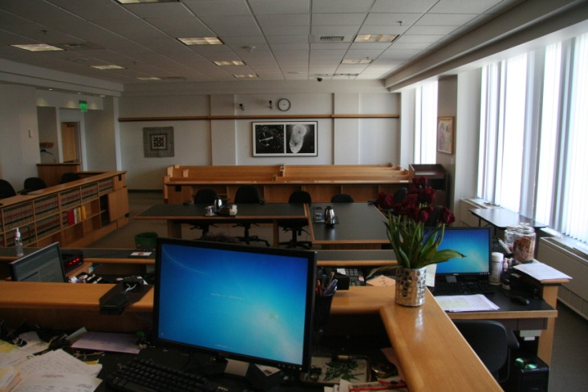
Connectivity
Department of Judicial Administration
“Getting stakeholders to use electronic court records”
Rooted in the Master Plan
Elevate ‘Connectivity’ to a project
Describe the scope of it to funders
Describe it as critical to your success
Notes:
Teresa

Slide 46
Connectivity Concerns Known
Department of Judicial Administration
Taking away the paper file can be traumatic
Stress, anxiety, appearance of competency
Modifications to the bench - view hindered
Large impacts to calendars
Requires changes in business processes
Notes:
Teresa
Tactile, color clues are gone
Trust issues
Describe your current process: write down exactly how documents flow through your paper system now

Slide 47
Connectivity Success Tips
Department of Judicial Administration
Obtain buy-in for transition away from paper; Select a date
Develop Service Level Agreements with partners
Define what you will deliver; What is expected from them
Set dates; Obtain signatures
Meet all expectations
Notes:
Teresa
Expand of Judge Trickey’s comments from the project management perspective
Protocol; SLAs; exceptions & reviews

Slide 48
Connectivity Success Tips
Department of Judicial Administration
Maintain a commitment to customer service
Learn actual use of court file & workflows
Ease the burden with tools
Get input on screens & specialized functionality
Provide training & help resources
Build a system easy to use
Notes:
Teresa
Expand of Judge Trickey’s comments from the project management perspective
Budget for computer equipment
Electronic sort of documents
Calendar based file queue

Slide 49
Our Changed Operations
Department of Judicial Administration
Receiving Documents: Approx 7,000 per day
Prepping & Scanning
Retention period of the paper document
E-Filed documents
Direct to Indexing
Notes:
Teresa

Slide 50
Our Changed Operations
Department of Judicial Administration
Indexing – Quality Control
Connecting a document with a case number
Quality control procedures
Sending to a workflow
Inherent efficiencies
Notes:
Teresa

Slide 51
Our Changed Operations
Department of Judicial Administration
Processing – Docketing
Eliminated dual entry
Automated some steps
Activity Log – Tracking
Replicate tracking of paper file
Enhanced with automated entries
Notes:
Teresa

Slide 52
Our Changed Operations
Department of Judicial Administration
Enhanced customer service
‘e’ Help desk phone & email communications
Process specific help & support phone numbers
Expanded online self-help resources
Process simple applications
Training opportunities - CLEs
Notes:
Teresa

Slide 53
Our Changed Operations
Department of Judicial Administration
Revenue Opportunities
What are customers willing to pay for?
e-Viewing, e-Working Copies; Expedited processes
Use revenues to off set the project costs or to cover the cost of new staff
Notes:
Teresa

Slide 54
Our Changed Operations
Department of Judicial Administration
Notes:
Teresa

Slide 55
The ECR Program Today
Department of Judicial Administration
No paper files*
Roughly 15,000 view requests are logged daily by the Court, Clerk’s staff, the public and King County agencies
Core ECR currently houses over 18.7 million documents
Notes:
Barb

Slide 56
The ECR Program Today
Department of Judicial Administration
Clerk’s new case filings processing time decreased 650% when received electronically
Paper filed new cases: 8 transactions per hour
e-Filed new cases: 60 transactions per hour
Average turnaround time: doc filing to access
Pre ECR (in 1999 & earlier): 5 days
Post ECR (2000): 2 days
Mandatory e-Filing (2009): 1 day
Notes:
Barb

Slide 57
The ECR Program Today
Department of Judicial Administration
Clerk’s Office Savings
Microfilming: $250,000 per year
File Folders: $23,000 per year
Staff Reductions: 27 positions
Total Savings: over $8 million since 2000
Notes:
Barb
Paper, for the most part, is not retained
$250,000/year was spent microfilming court records for permanent preservation
Reduction of $23,000/yr spent creating file folders for the approximately 70,000 cased filed each year
Reduction of one position required to transport documents, files and exhibits between the 3 court locations, the court of appeals and the supreme court
Core: A number of staff had to receive and file the 7,000+ documents each day.
Connectivity: Other staff would receive internal and external customer requests for files to retrieve.
Agencies can self-serve their own copies
Resulted in significant savings in paper, postage, and time spent copying documents
Reduced storage costs
Productivity gains – prepping and scanning
in January-June of 2011, we collected $169,206.35 from ECR Online payments. This would correspond to payment for 1,128,042 pages at the current price of $0.15/page.

Slide 58
E-Filing Today
Department of Judicial Administration
Between January 2011 through June 2011:
45% of the 829,556 documents filed were e-filed (371,987 documents)
9,939 eWorking Copies submissions received ($198,780)
$169,206 collected from ECR Online payments
Notes:
Barb
in January-June of 2011, we collected $169,206.35 from ECR Online payments. This would correspond to payment for 1,128,042 pages at the current price of $0.15/page.

Slide 59
King County ECR Experience
Department of Judicial Administration
A Change in Business:
Change Management
and
Electronic Court Records Today
Questions?

Slide 60
King County ECR Experience
Department of Judicial Administration
The Move to Mandatory E-Filing:
Meeting the Needs
of the Bar
Teresa Bailey, Deputy Director

Slide 61
E-Filing: Meeting the Needs
Department of Judicial Administration
Session Agenda
E-Filing: The Project
Move to Mandatory E-Filing
The eFiling Application

Slide 62
The E-Filing Project
Department of Judicial Administration
Faster, Better, Cheaper
Convenient document filing via the internet
Decrease clerk’s document processing time
Increase record quality: color photos, clean text
Enable customer savings & process efficiencies
Build It & They Will Come….
Notes:
Afterhours filing – remote locations
Color photos, clean documents, easy to read

Slide 63
The E-Filing Project
Department of Judicial Administration
Build It & They Will Come…. Not our experience
Attorneys supported idea, however:
Requires business process change
for firms, agencies and offices;
Not required, Won’t do

Slide 64
E-Filing: The Next Step
Department of Judicial Administration
In 2007, updates to State General Rule 30 enables local court’s authority to mandate e-filing
DJA was facing huge budget cuts in 2008; many options were considered
Customer feedback encouraged us to mandate e-filing for attorneys
eWorking Copies Pilot project
Notes:
Budget Options considered:
Increase revenue: Resulting in higher fees
Reduce services/staff: Resulting in longer lines and processing time - potential backlogs
Create efficiencies: this is the strategy we chose to pursue
How we finally made our choice - We asked and we listened :
Focus groups - Attorney customers suggested that we move to implement mandatory e-filing provided we could solve the working copies issue
Input from current e-filing users
Pilot projects
User comments/questions reported to us by our customer service staff

Slide 65
Clerk’s Efforts Support Mandatory E-Filing Success
Department of Judicial Administration
Creation of Local General Rule 30 to guide the practice
Engaged in community outreach & marketing
Promoted: Free, Easy, Convenient & Green
Provided eFiling CLE demo: over 2500 participants
Assigned staff liaisons with agencies and departments
Notes:
Marketing paid for through the Ash Institute grant fund to promote award wining innovations in government: Posters, flyers & business cards spreading the mandatory e-filing message and Clerk’s Office support resources
DJA staff liaisons helped education and resolve agencies / departments adjust and prepare for e-filing (OPD, PAO, DSHS, KCSC, KCBA, large firms….

Slide 66
Clerk’s Efforts Support Mandatory E-Filing Success
Department of Judicial Administration
Implemented enhanced - streamlined eFiling application functionality
Expanded Customer Service Support
eServices help desk: phone & e-mail
eFiling webpage: FAQs, video tutorials, step-by-step guides, application demos, contact #s
Developed phased approach to waiver process
Supported learning processes
Notes:
Enhanced application implemented shortly before mandatory e-filing to streamline the process and add new features (WC & EXP)
Added staffed eServices desk
Developed e-filing webpage and a variety of resources in different formats. Self-help
Waiver request accepted for a case, time period or document
Process encouraged learning e-filing process: time period waiver, one-on-one training

Slide 67
The eFiling Application
Department of Judicial Administration

Slide 68
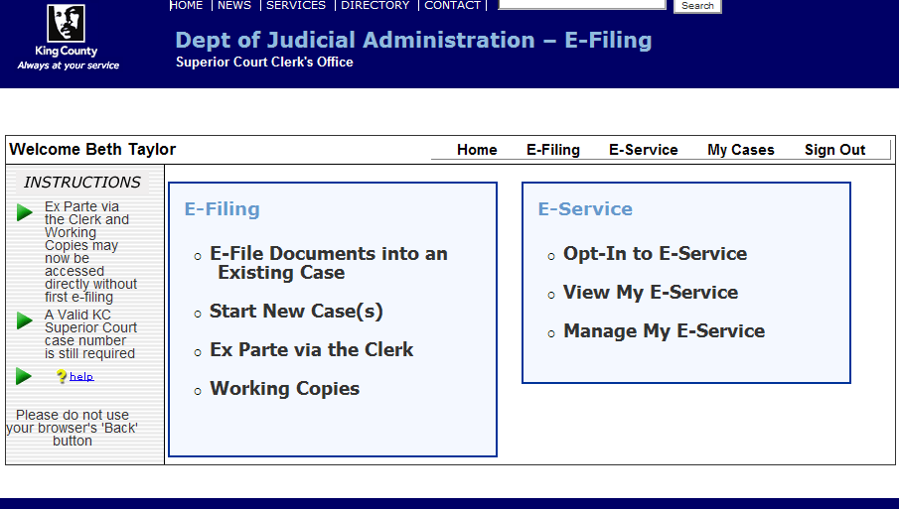
The eFiling Application
Department of Judicial Administration
Four Distinct Electronic Processes
Notes:
Filing documents into an existing case or start a new case
Electronic service of eFiled documents
Submit Judge’s Working Copies electronically
Electronic Ex Parte via the Clerk submittals

Slide 69
The eFiling Application
Department of Judicial Administration
Administration Functionality: Table Management
New Case Category > Sub-category Options
Documents Type identification
Fee / No fee
SCOMIS codes
Minimum initiating documents required
Case Types requirements
Minimum required document(s)
Role based process flow: Criminal queue
Case Schedule / Case Information Cover Sheet
Notes:
Table functionality allows for flexibility.
Flag particular codes / table items for special processes

Slide 70
The eFiling Application
Department of Judicial Administration
User Role Based Functionality
Public: Free for non-fee filings, eCommerce for fee payments, Shopping Cart, eService & eWorking Copies
DPA: Pre-filing judicial review submission process, bypass eCommerce
Judge: Electronically sign orders (digital signatures), e-mail filed documents, MS Word orders
Clerk / OPD: Batch submissions

Slide 71
The eFiling Application
Department of Judicial Administration
Case Number Validation
File Format Validation
PDF or TIF (MS Word for specific roles & process)
Orientation: portrait (file stamp placement)
Page size: 8.5” x 11”
Margins: 3” top on page one, 1” other pages
File size limitation: 5 MB (50 MB per submission)
Notes:
Error messages identify issue for customer
Word Documents are converted to PDF at Stamp Server

Slide 72
The eFiling Application
Department of Judicial Administration
User Benefits
Review uploaded file(s) & case info before filing
Immediate access to filing confirmation
Auto creation and access to case schedule
Shopping Cart functionality
eCommerce: Credit card or Internet check
Supplemental processes: eService, eWorking Copies, submission of proposed orders in Word

Slide 73
The eFiling Application
Department of Judicial Administration

Slide 74
King County ECR Experience
Department of Judicial Administration
The Move to Mandatory E-Filing:
Meeting the Needs
of the Bar
Questions?

Slide 75
King County ECR Experience
Department of Judicial Administration
Technical Aspects of the
King County
Electronic Court Records Program
Teresa Bailey, Deputy Director

Slide 76
Technical Aspects of ECR
Department of Judicial Administration
Session Agenda
Technology Standards
ECR Technical Overview
Technology Downtime
Tech Lessons Learned

Slide 77
Technology Standards
Department of Judicial Administration
Washington State Technology Standards
Be familiar with the other systems: Customers will compare
Federal PACER application
Pierce County LINK
King County ECR Program

Slide 78
Technology Standards
Department of Judicial Administration
User Friendly Applications
Training not required; provide training
Limit process steps; keep it simple
Develop specialized functionality
Be mindful of the future; What’s next?

Slide 79
Technology Standards
Department of Judicial Administration
Safety Nets: System redundancy and failover
Duplicate platform: Protect against data corruption & software failure
In-house development vs. Outside Vendor
Build a system that can grow: modular & scalable
Notes:
Per Carol: Historically we have a very good record. The production system has several safety nets in place for system redundancy and failover. Our production system runs simultaneously with a duplicate platform which is configured identically to the production platform, failover. This duplicate platform is at the ready to accept production processing should the production hardware fail.
In order to protect against data corruption or software failure, our data is safeguarded in multiple locations and system build procedures and files are available to reconstruct the system on either of two fully functional platforms. These safety nets provide system availability when either software or hardware or both fail. King County IT provides network and power redundancy.
Any system that can grow, as ours has, should be built both modular and scalable for all aspects of the system. At King County we are preparing to replace the current ECR with a more modern version and scalability is a key requirement for the new system.
We recommend the same for any agency contemplating such an implementation.

Slide 80
ECR Technical Overview
Department of Judicial Administration
Functions Supported
Clerk’s technology team: Manager & 10 staff
Infrastructure
4 locations: King County Courthouse, Maleng Regional Justice Center, Juvenile Court and the County’s data center
Data Storage
FileNet system 5 TB for data
Notes:
Per Ashley: The FileNet system currently uses 5TB for data and 1 TB for the OS/Application. FileNet will grow by at least ½ TB a year.

Slide 81
ECR Technical Overview
Department of Judicial Administration
Core ECR: Image management system
Document Management System (DMS): Read-only repository of case document images (.pdf)
Notes:
Add notes from here:
http://www.kingcounty.gov/courts/ECRlibrary/how-does-ECR-work/technology.aspx

Slide 82
ECR Technical Overview
Department of Judicial Administration
Image from paper
Scanner
efiling
ECR Online
File stamped
Electronic submissions
ECR Core
Case files
ECR Web
DMS
Delta Viewer and Intranet Public -
SC document image requests
Case files

Slide 83
Technology Downtime
Department of Judicial Administration
Hardware / Software Issues Will Occur: Be Prepared
Develop a plan:
Notification mechanism: internal & external
Create & document application down filing process
Document and test process plan
Be ready for the publicity

Slide 84
eFiling Application Status Page
Department of Judicial Administration
Notes:
Allows for customers to verify that the application is up and running successfully, therefore, if they have issues they should investigate their internet connection and equipment.

Slide 85
eFiling Application Status Page
Department of Judicial Administration
Notes:
Each filing process requires unique information for a successful filing. Separate instructions allow for a process (e-filing, eEx Parte via the Clerk or eWorking Copies) to be inaccessible and not negatively impact the other processes.

Slide 86
eFiling Application Status Page
Department of Judicial Administration
If eFiling application or a component is unavailable customers:
Access status page via internet – outside KC network
Select process link and print coversheet provided
Input submitter’s contact & process specific information
Comply with an alternative filing option:
File in hard copy at any Clerk’s Office location, or
Fax file during normal business hours
Notes:
The coversheet form provides process specific submittal information and requests necessary information to complete.
Includes date and time (verification) of application down.

Slide 87
Technology Lessons Learned
Department of Judicial Administration
Once your constituency is on board & using ECR, users will expect the next best thing to be added
Do not underestimate how dependent you & your constituency will become on electronic court records, electronic processing & e-filing
Invest in tech staff or a contract for maintenance and support
Notes:
Prioritize business functionality
Technology – trust by verify

Slide 88
Technology Lessons Learned
Department of Judicial Administration
Acknowledge that what you are building is an Enterprise System – much bigger and brings much more responsibility than a system used only by your employees
Staff up to make sure you have enough tech support for an enterprise system
Technology breaks – have failover and standby systems; test & document
Notes:
Contingency Planning – what and when
Disaster Recovery – keeping the doors open
Standby – replicates full functionality

Slide 89
King County ECR Experience
Department of Judicial Administration
Technical Aspects of the
King County
Electronic Court Records Program
Questions?

Slide 90
King County ECR Experience
Department of Judicial Administration
Key Lessons Learned
Barbara Miner & Teresa Bailey

Slide 91
Lessons Learned
Department of Judicial Administration
Session Agenda
In Support of the Master Plan
Project & Change Management
Communications
Challenges Will Occur
Lesson Learned
Notes:
Barb

Slide 92
The ECR Master Plan
Department of Judicial Administration
Before: Best intentions, but … confusion
Many leaders saying great things – all just different enough
Committees’ roles were confused
Project staff roles not clearly defined
Operational managers bumping into project managers and staff
Notes:
Barb

Slide 93
The ECR Master Plan
Department of Judicial Administration
Before: Best intentions, but … confusion
High level thinking wasn’t being translated into day-to-day operations
No written guidance, no reference book
Strong need to get everyone on the same page
Notes:
Barb

Slide 94
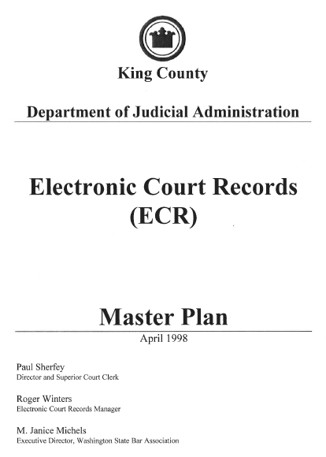
The ECR Master Plan
Department of Judicial Administration
After: A key document
It brought us all together
Kept us from re-visiting the same questions over & over
Was used to communicate to funders & constituents
Laid out where we were going
Notes:
Barb

Slide 95
Project Management
Department of Judicial Administration
Involve a sponsor / leader from the toughest constituency
Acknowledge, appreciate & capitalize on all that your staff knows
Include customers in the process: focus groups, user groups, surveys, pilot projects
Don’t assume you know what they want when it comes to specifics
Notes:
Barb

Slide 96
Project Management
Department of Judicial Administration
Segmented implementation – any one phase is a “win”
Specialized features can be a huge efficiency
Good ideas or missed things come up during project development
Start a new project or new phase that is “enhancements” or “new components” from the parking lot
Notes:
Barb

Slide 97
Change Management
Department of Judicial Administration
Acknowledge connectivity as a phase in your project: plan & budget for it
Develop Service Level Agreements with partners: court, prosecutor, defense
Define what you will deliver & what is expected; Set review dates
Printing is much cheaper than maintaining paper files; print for anyone who asks
Notes:
Barb

Slide 98
Communications
Department of Judicial Administration
There is no such thing as too much communication
You cannot under estimate the change that will be taking place
Communicate a vision beyond the initial implementation
Make a plan for each and every constituent group
Form a subcommittee to resolve an issue
Notes:
Teresa

Slide 99
Communications
Department of Judicial Administration
Internal Communications
Create a Communications Committee
Establish check points during the process to celebrate achievements
Keep staff informed throughout the process
Weekly “Did you Know?” emails, countdown quiz, created video – be creative
Notes:
Teresa

Slide 100
Communications
Department of Judicial Administration
External Communications
Involve impacted groups up front
Learn what’s pressing the hot buttons
Assign a liaison to each agency
Pilot changes where possible
Notes:
Teresa

Slide 101
Communications
Department of Judicial Administration
General Communications Strategy
Be ready to answer tough questions
Legality issues
Technology issues
Security & privacy issues
Comparisons to other applications or courts
Know that not everyone will embrace change
Notes:
Teresa

Slide 102
Communications
Department of Judicial Administration
General Communications Strategy
Think of it as Marketing
Posters, Flyers, brochures, business cards, Clerk’s Alerts, TV messages, etc
Press Releases: Partner with a vendor
Seek recognition
Notes:
Teresa

Slide 103
Vendor Contracts
Department of Judicial Administration
Write good technology vendor contracts & stick to them
Vendor has a project manager and you have a project manager
Any single item you ignore on a contract will lead to problems enforcing any of your contract
Everything must be in writing
Notes:
Teresa

Slide 104
Challenges Will Occur
Department of Judicial Administration
Maintaining Two Systems at Once …
Allowed judicial officers & attorneys to acclimate to the electronic record
Provided opportunity to compile statistics showing a drop in hard copy file requests
Resulted in the loss of Clerk’s Office staff & drained morale
Notes:
Barb

Slide 105
Challenges Will Occur
Department of Judicial Administration
Catalysts for Change
A Juvenile Justice Center fire destroys some paper records = Transition to ECR as the official court record
Budget reductions & customer reactions = Mandatory e-filing
5 Long Weeks = Re-examined notification & downtime work processes
Notes:
Barb

Slide 106
Lesson Learned
Department of Judicial Administration
It’s not about the technology, it’s about the business paradigm shift to the Electronic Court Record as the official court record
Should you do what we did?
No – not exactly
Learn from us and do what’s right for you
Notes:
Barb

Slide 107
King County ECR Experience
Department of Judicial Administration
Key Lessons Learned
Questions?

Slide 108
Electronic Court Records: The King County Experience
Department of Judicial Administration
Contact Information
Hon. Michael J. Trickey, Superior Court Judge
michael.trickey@kingcounty.gov
206-296-9265
Barbara Miner, Superior Court Clerk
barbara.miner@kingcounty.gov
206-296-7866
Teresa Bailey, DJA Deputy Director
teresa.bailey@kingcounty.gov
206-296-7866

