Slide 1
Outbreak disclosure & notification
Meredith Li-Vollmer, PhD
Risk Communication Specialist

Slide 2
Disclose or not disclose? How we used to decide
Risk to the public?
Action we want people to take?
Notes:
Example from foodborne illness outbreak notifications. We always want to avoid premature blame and encourage restaurants and individuals to work with us. These criteria are standard practice among health departments.

Slide 3
Disclose or not disclose? 5 ill from E. coli (July 2015)
Outbreak over by the time we found out, all product thrown out
No problems found, all employees tested
No risk to public
Nothing we could advise public to do
Didn’t disclose

Slide 4
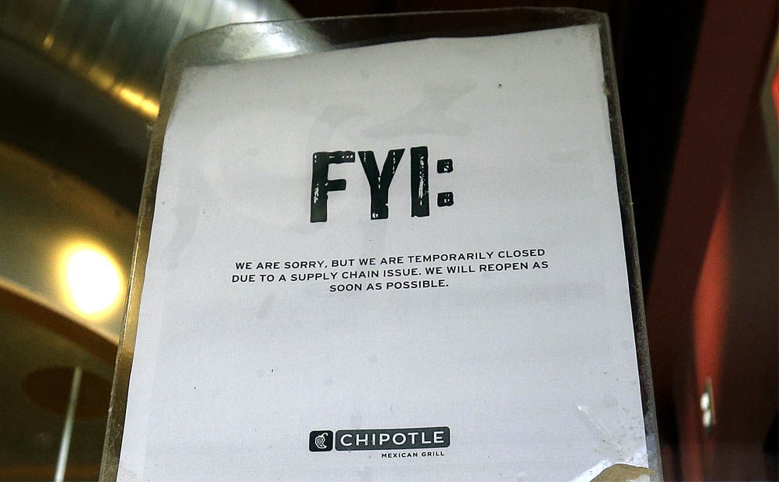
November 2015
Notes:
But come fall, another strain of E. coli…and it’s the same restaurant. Maybe you heard about this one?

Slide 5
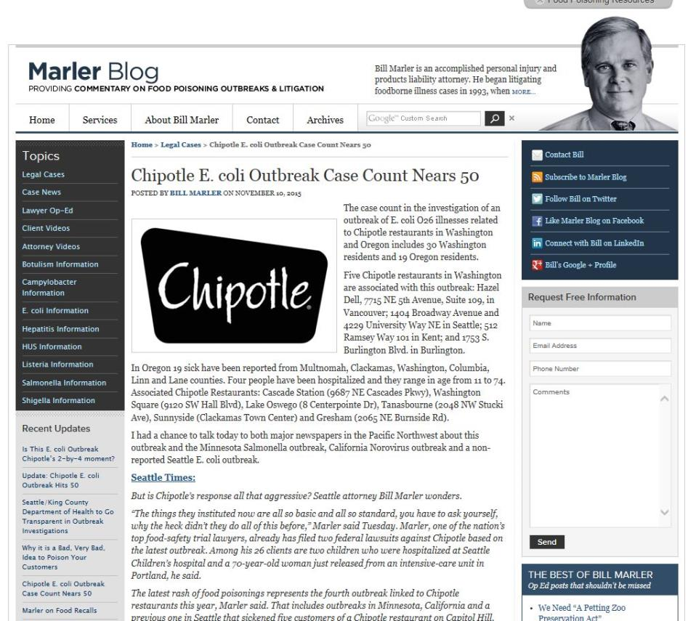
Enter the lawyer
Notes:
Lawyer who specializes in food borne illness litigation was contacted by someone who had E. coli earlier in July connected to Chipotle. We had in fact had a much smaller outbreak of a different strain of E. coli involving 5 people who had eaten at Chipotle for which we had not done a public notification. This lawyer started pitching the story to media in this region and nationally.

Slide 6
The media took the bait
Notes:
Result: outrage
Focus was not on all the good work we were doing with the bigger, multi-state outbreak. Attention now turned to something that was no longer a threat, but evoked stronger emotions.

Slide 7
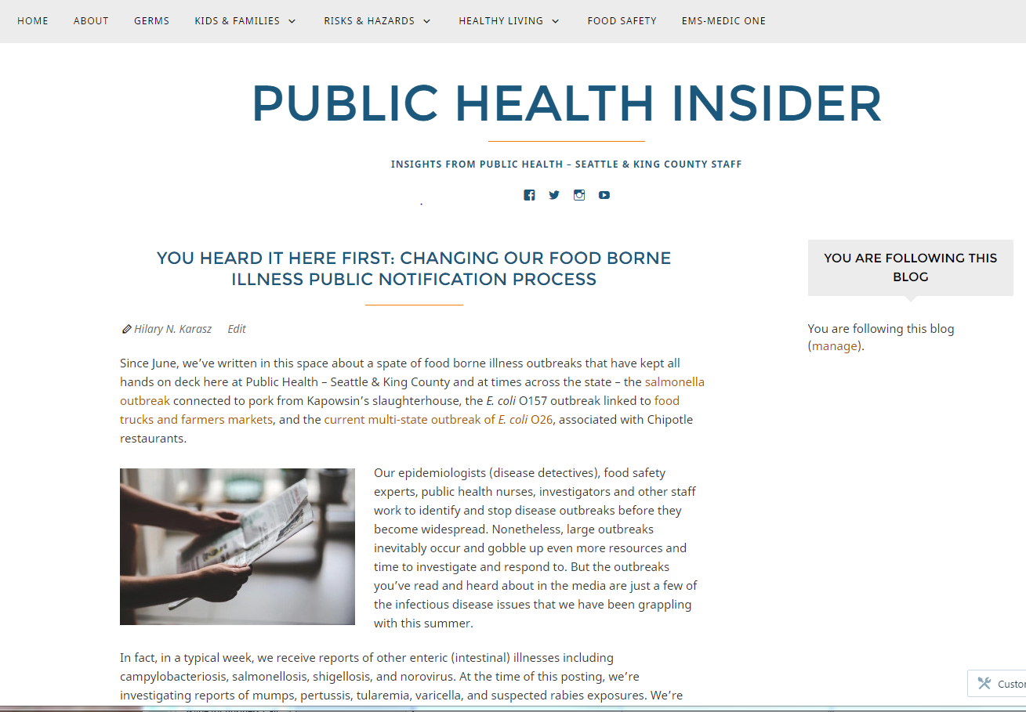
Our response
Notes:
We continue to issue news releases and social media alerts related to outbreaks that present a risk to the public. But we’ve added something new: an outbreak website where we routinely post information about likely or confirmed foodborne illness outbreaks, even if there is no ongoing risk or if there is not a recommended action for the public to take. By putting it on a website, it allows us to include context that will help readers avoid drawing inaccurate or premature conclusions. We also update the information as the investigation progresses.

Slide 8
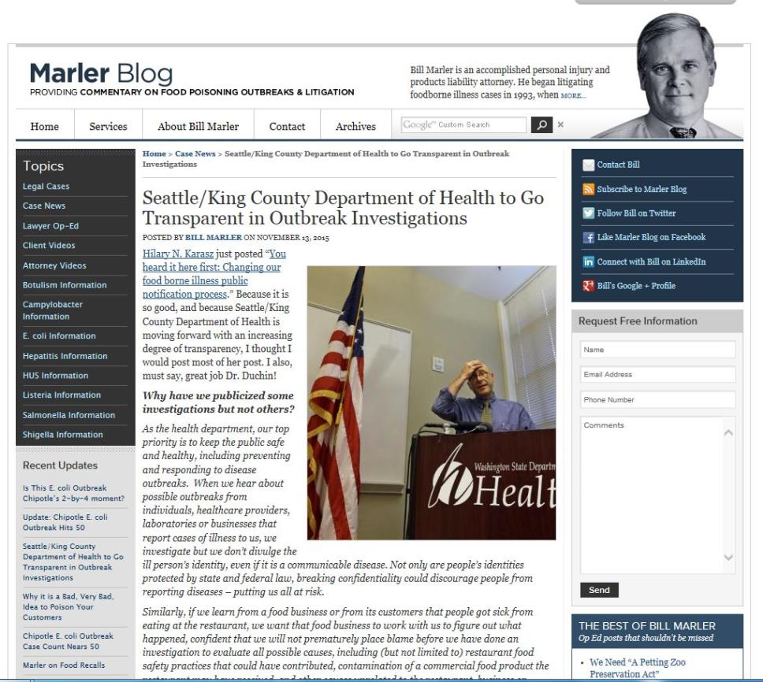
The lawyer’s response
Notes:
Posted our blog almost verbatim: “Because it is so good, and because Seattle/King County Department of ehalth moving forward with an increasing degree of transparency, I thought I would post most of [it]. I also must say, great job Dr. Duchin!”

Slide 9
The public’s simple message:
WE EXPECT MORE TRANSPARENCY
Notes:
It’s a simple, compelling message that’s hard to counter.
And increasingly, there are advocates involved, whether it’s a consumer advocate, a lawyer, or a government watchdog.

Slide 10
Reducing outrage
Building trust
Notes:
When people think you’re hiding something, they tend to feel outrage. And when they have that heightened emotion, they are more likely to have elevated perceptions of risk. What’s more, heightened emotions often makes it difficult for people to process information and they will be less able to listen to any additional information.
Of course, disclosing that there has been a potential risk of infection will be upsetting for people. But it won’t be at the same level as if there’s a perception that you’ve been hiding something. If you’ve been forthcoming, at least you can start to build back some trust so that people will be more likely to listen to what you’ve been doing that’s right.
Otherwise, you face potential criticism on two fronts: for any perceived breach AND how you’ve handled it.

Slide 11
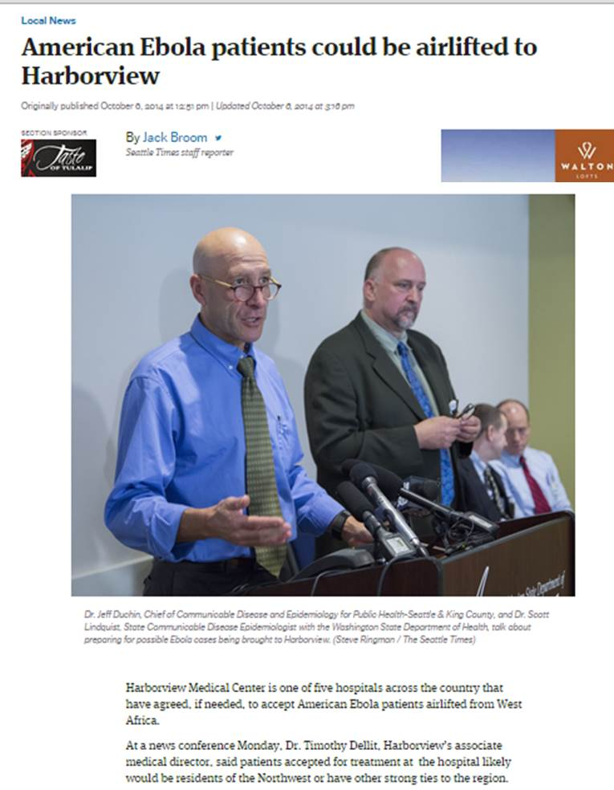
Notes:
Example of when transparency paid off: When Harborview responded to the State Department’s call to consider accepting medical evacuees from West Africa, just 2 weeks after the Dallas Ebola case, we debated whether we should go public with the information. There were reasonable arguments for not saying anything. It was unknown whether there would ever be an Ebola case sent to Harborview, so some felt it would alarm people unnecessarily.
But working with Harborview and DOH, we decided that it would be better to be transparent to prevent greater outrage if an Ebola patient was sent there and the public hadn’t been prepared. Also, we felt it would build trust with the media and the public.
And it did. Number of calls from reporters asking about rumors of Ebola patients went down, media coverage was very calm and measured when we did have our first Ebola case for testing. They believed us when we told them that we would keep them updated.

Slide 12
Transparency
isn’t always easy
Notes:
Many good reasons why it’s challenging:
Avoid disclosure of PHI
Don’t want to unnecessarily alarm patients
Information about the causes of infection or outbreaks are often unclear or inconclusive
There is not always an action that people can take
The risk may no longer be present
But given the potential damage to public trust if you’re seen as hiding something, it’s worth working through these issues and figuring out how you can be more transparent.

Slide 13
You don’t have to have all the answers
Notes:
Here is a recent example of an institution that opted to share what they could, even when they didn’t yet have all the information about an emerging situation. The Auburn School District uncovered an 8-year-old report showing elevated lead in multiple schools, but they didn’t know if the problems had been corrected, especially since the leadership had turned over since the report was issued.
Rather than sit on the information, they notified students and families as soon as possible, did a media release and briefing, even more before they had all the information. In paid off in the measured media coverage and low numbers of calls or emails from parents and staff.

Slide 14
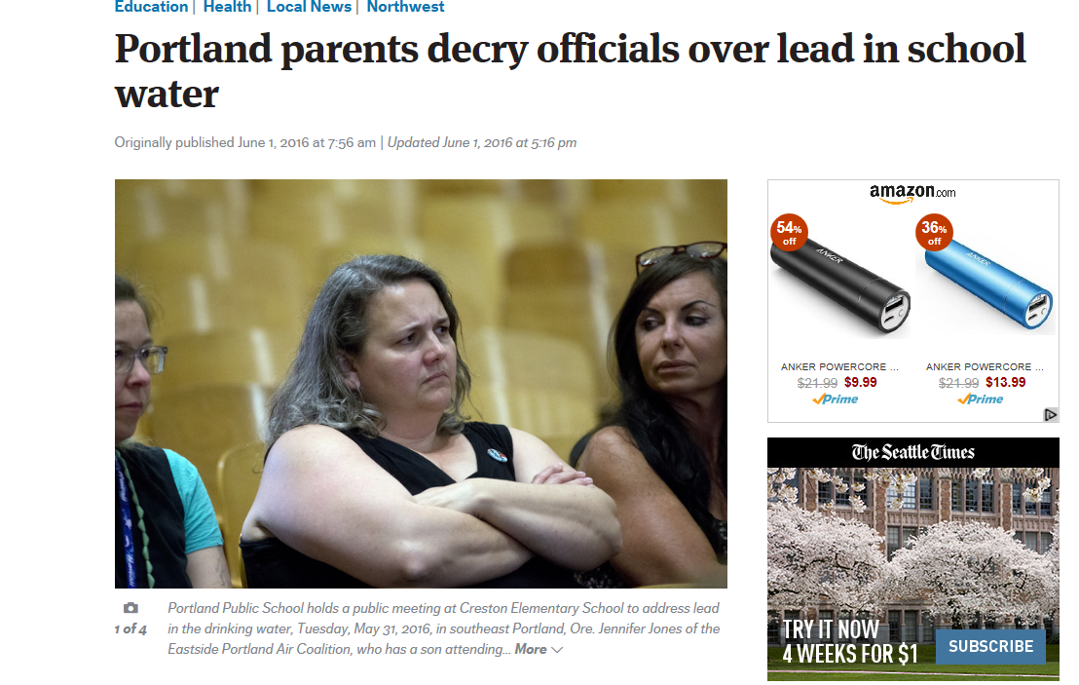
Portland Public Schools waited…
Notes:
Just this week, the Portland School District was in the news because they did not notify families or the media about elevated lead in the water of some schools until it was disclosed by public records request. Parents groups are now calling for the resignation of the Superintendent.
So if you’re Auburn School District, you might not get kudos called out for the great job you did being transparent, but if you’re like Portland, you’ll sure hear about it if you don’t.

Slide 15
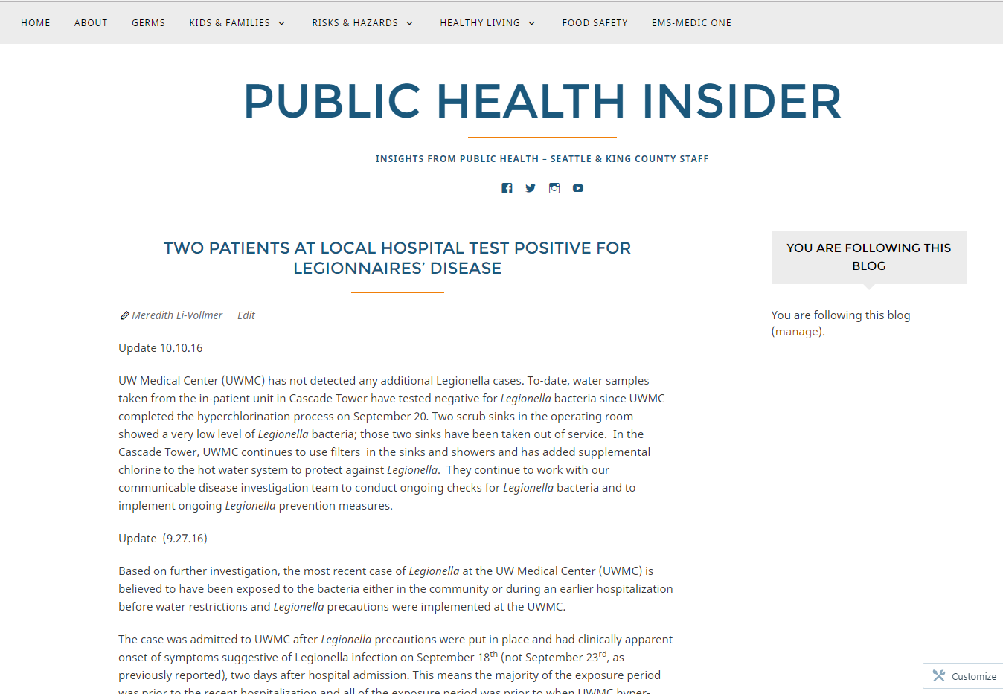
Notes:
We are doing more notifications of hospital associated infections, in coordination with DOH and our healthcare partners. As with foodborne illnesses, we have an obligation to inform the public if there’s an outbreak that’s a public health risk, or if there is a risk for former patients and it’s difficult to reach them by phone call or letter alone. We also may do public notification if testing is recommended and the healthcare facility can’t reach the entire patient population at risk.
And there’s also considerations about being able to get out ahead of the story if we think it’s likely to leak. Most common ways info gets out is through staff or patients and their families, particularly on social media. By coordinating our messages and demonstrating a desire to keep the public informed, helps maintain trust and credibility.

Slide 16
Resources
CDC Patient Notification Toolkit
http://www.cdc.gov/injectionsafety/pntoolkit
Public Health’s foodborne illness outbreak investigations: http://kingcounty.gov/healthservices/health/communicable/diseases/outbreak.aspx
Meredith Li-Vollmer, meredith.li-vollmer@kingcounty.gov

